Slide 1
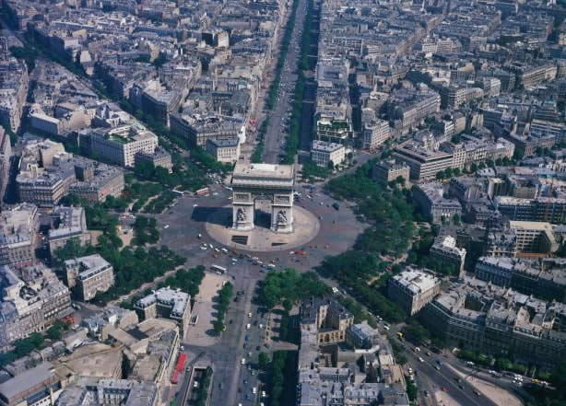
French 2 Chapitre 1-2
Géoculture - Paris

Slide 2
The City of Lights
Paris is known as la Ville lumière, but few agree on the origin of this nickname.
Notes:
Some say it stems from the many lights that illuminate the city and its monuments, while others claim it is due to Paris’s cultural and intellectual energy.

Slide 3
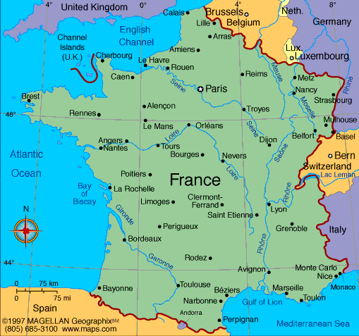

Slide 4
Almanac
Name of the inhabitants: Parisians
(Fr: Les Parisiens)
Population: More than 2 million inhabitants
Famous people: Jacques Chirac, Catherine Deneuve, Edith Piaf, Jean-Paul Sartre

Slide 5
History of Paris
Paris was first settled in the 3rd century BC by a tribe of Celtic Gauls, called the Parisii.
The Romans then ruled the city from 52 BC until the 5th century when the Germanic Franks took control.
The Frankish king Clovis I united Gaul, France’s name at the time, and made Paris the capital of his kingdom in 508.
Except for two periods during France’s history, Paris has been the country’s capital.

Slide 6
Geography
The Seine River flows from east to west in a seven-mile arc, dividing the city between la rive gauche (Left Bank) and la rive droite (Right Bank). It then curves north, passing la Défense.
The île de la Cité and île St-Louis, the two islands in the middle of the Seine, form the heart of the city.

Slide 7
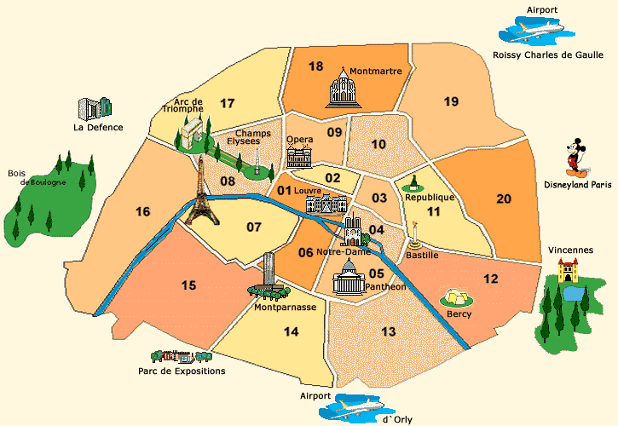
20 Arondissements

Slide 8
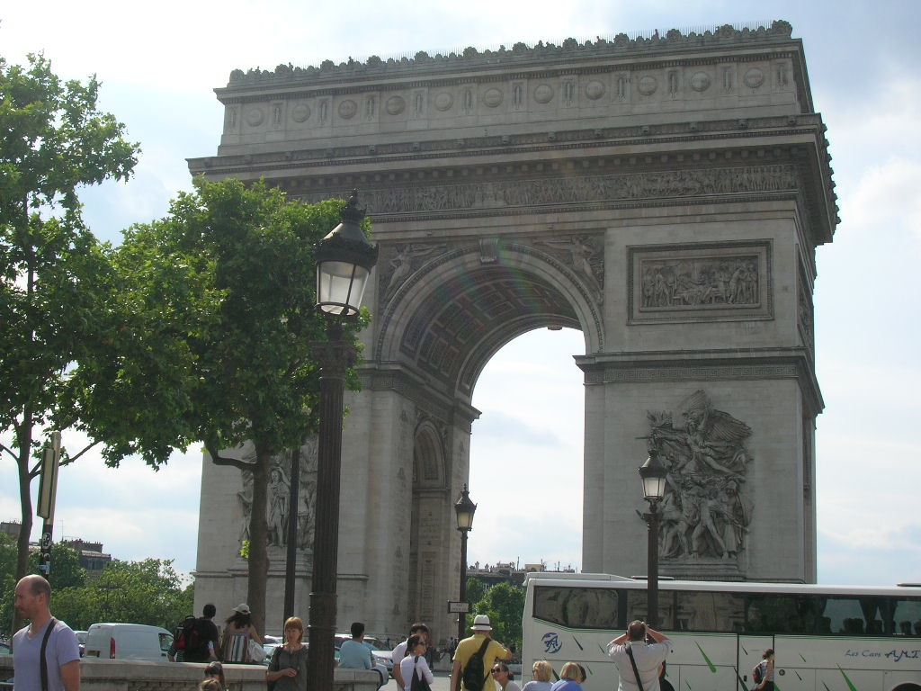
L’Arc de Triomphe
Napoleon ordered the construction of this monument in 1806.
It is situated at the intersection of 12 avenues.

Slide 9
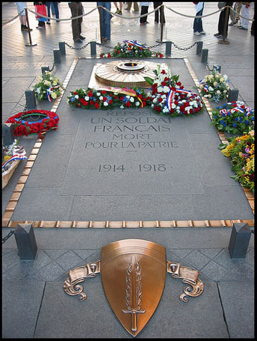
Tomb of the Unknown Soldier
Notes:
At the base of the Arc de Triomphe, the remains of an unknown soldier from WWI are buried.
Every evening at 6:30, people lay wreathes of blue, white, and red on the tomb and relight a torch.
This flame symbolizes the sacrifices made by young men who gave their lives during the war.

Slide 10
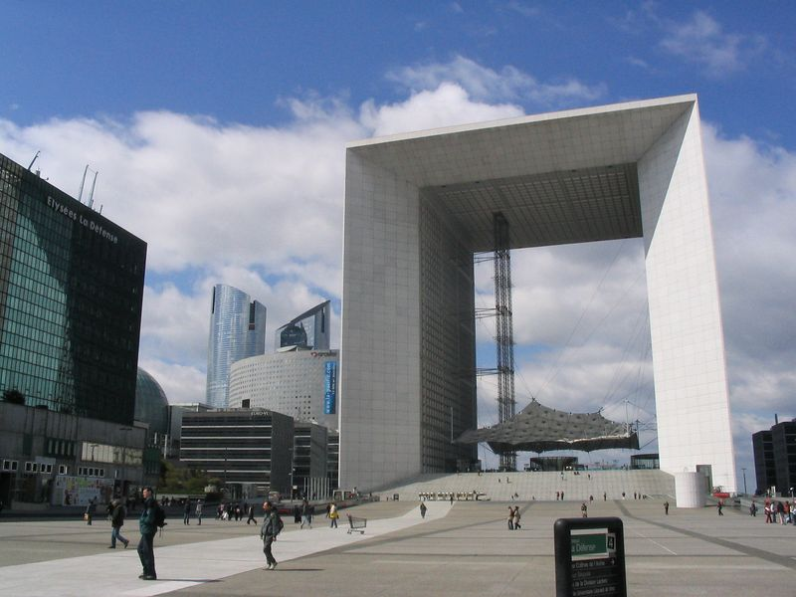
La Grande Arche de la Défense
This immense arch is aligned with the Arc de Triomphe and the Louvre.
There are office buildings on the inside.

Slide 11
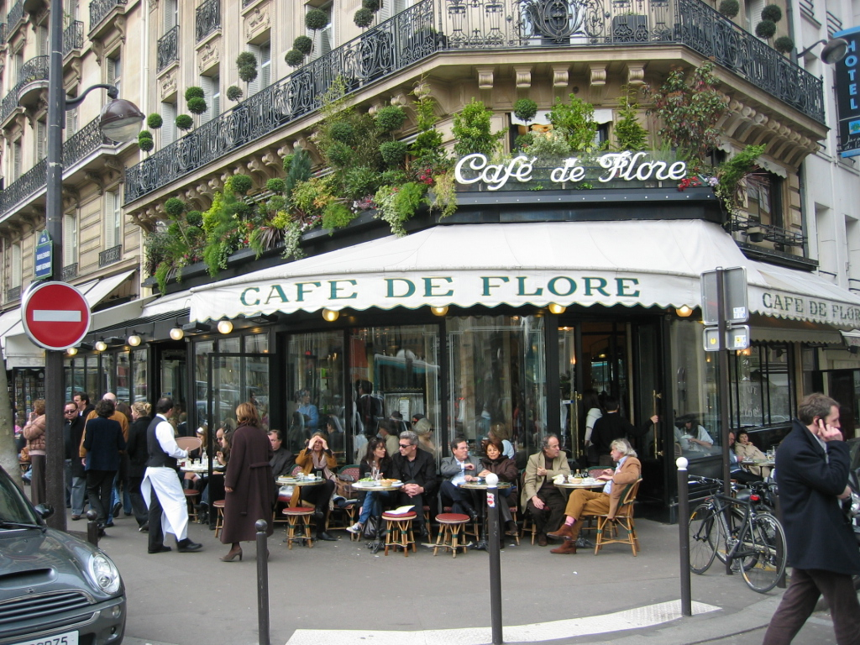
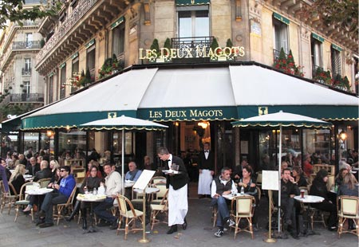
Les cafés
Parisians love to meet in cafes.
Le café de Flore ⬆ and Les Deux Magots ➔ are two famous cafes in Paris.

Slide 12
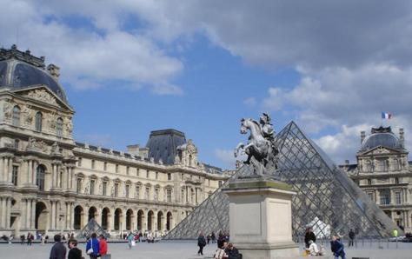
Le Louvre
Originally it was a fortress, then a royal palace, and today a large museum.
The glass pyramid was built by American architect I.M. Pei.
Notes:
1. The Louvre is over 800 years old.
2. Designated a museum in 1793, its collection has over 300,000 works, assembled over five centuries.
3. Some of the most important pieces in its collection are La Jaconde, or Mona Lisa, and the Venus de Milo.

Slide 13
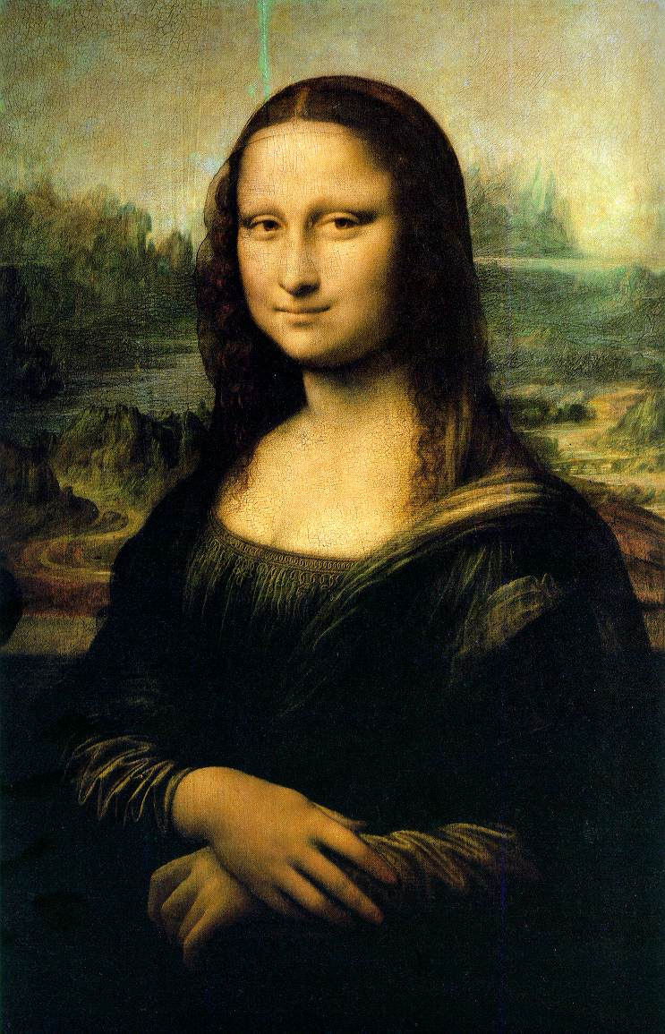
Leonardo da Vinci “La Jaconde” (Mona Lisa)
Notes:
This painting is actually very small in real life. And full of rich detail.

Slide 14
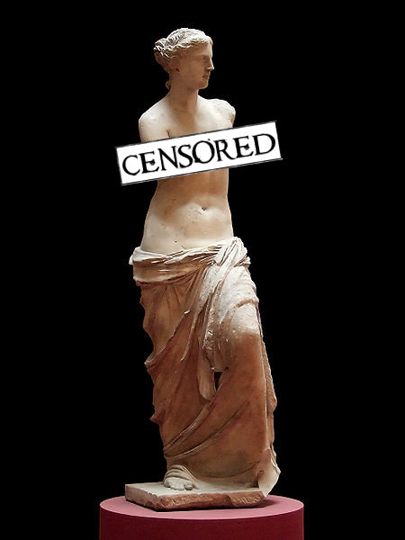
Venus de Milo

Slide 15
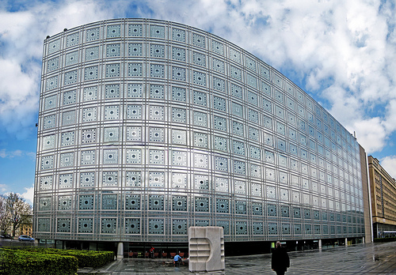
L’Institut du monde arabe
The Arab World Institute symbolizes the exchanges between two cultures.
It’s a modern building inspired by traditional Arab culture.

Slide 16
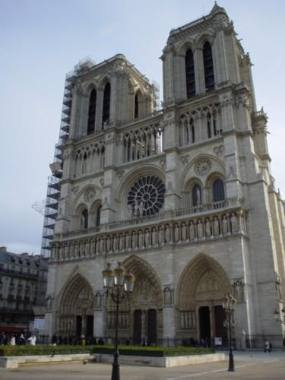
Notre-Dame de Paris
Construction began in 1163.
It’s a masterpiece of gothic art.
Located on île de la Cité.
Caught fire 4/30/19.
Notes:
Reconstruction has already begun. A 5 year plan was set by President Emmanuel Macron to rebuild the 850-year-old cathedral.

Slide 17
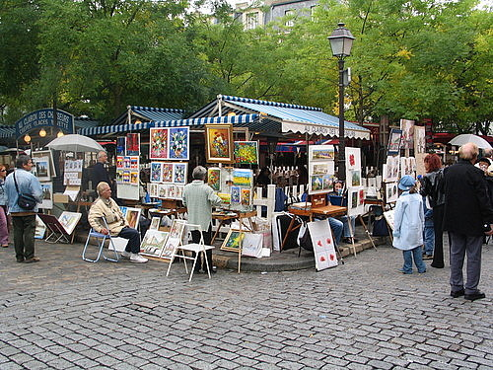
La place du Tertre
Located in the Montmartre neighborhood of Paris and has preserved a village atmosphere.
It’s the meeting place of local artists.
Notes:
In the late 19th and early 20th centuries, many important artists lived or worked near the place du Tertre in Montmartre.
One of the most famous was Pablo Picasso, who, from 1904 to 1909, lived and painted in a building called Le Bateau-Lavoir.
Other artists who drew inspiration from and worked in the area are Vincent Van Gogh, Henri Matisse, Pierre-Auguste Renoir, Edgar Degas, and Toulouse Lautrec.

Slide 18
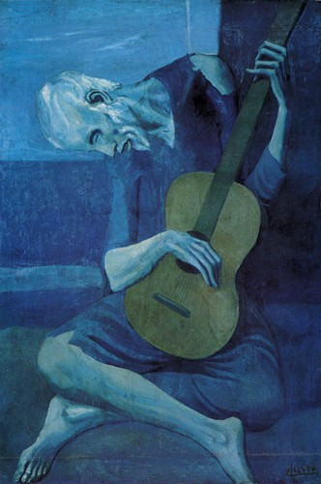
Pablo Picasso “The Old Guitarist”

Slide 19
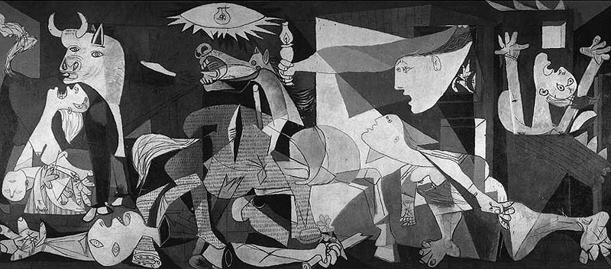
Pablo Picasso “Guernica”

Slide 20
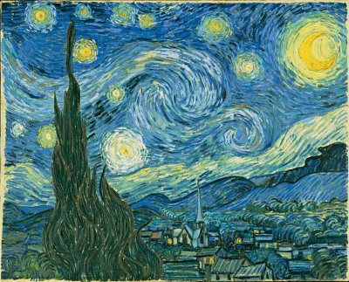
Vincent Van Gogh “The Starry Night”

Slide 21
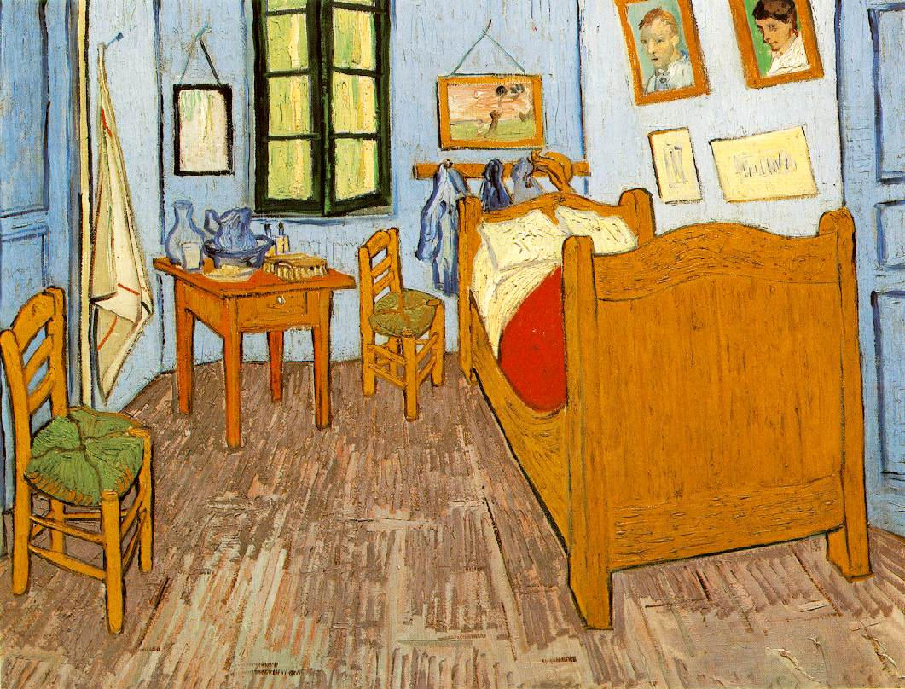
Vincent Van Gogh “La chambre de Van Gogh à Arles”

Slide 22
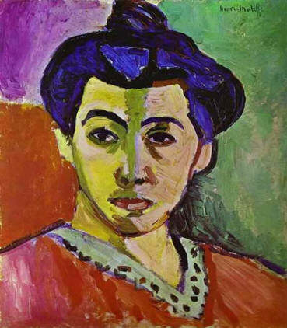
Henri Matisse “Green Stripe”

Slide 23
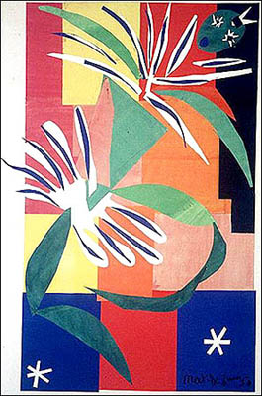
Henri Matisse “Creole Dancers”

Slide 24
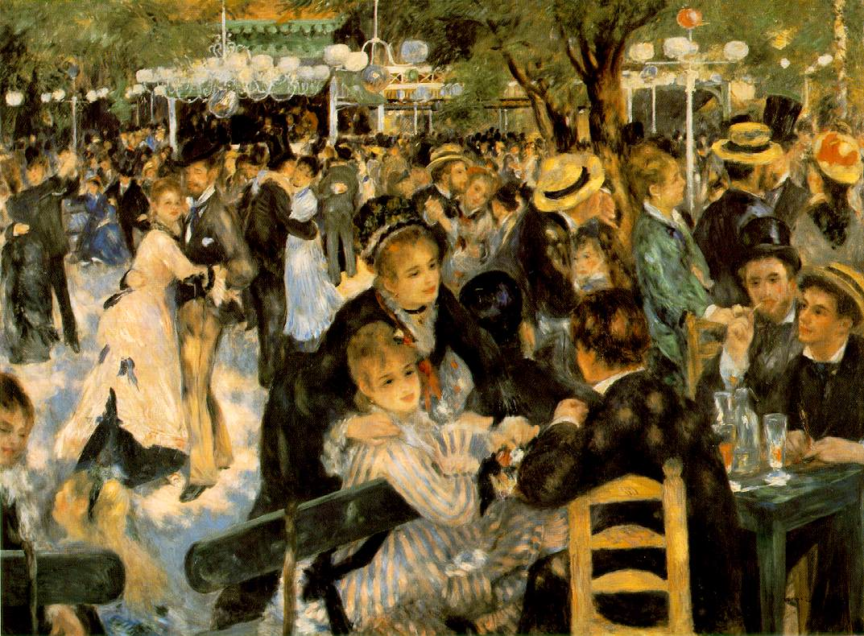
Pierre-Auguste Renoir “Le Moulin de la Galette”

Slide 25
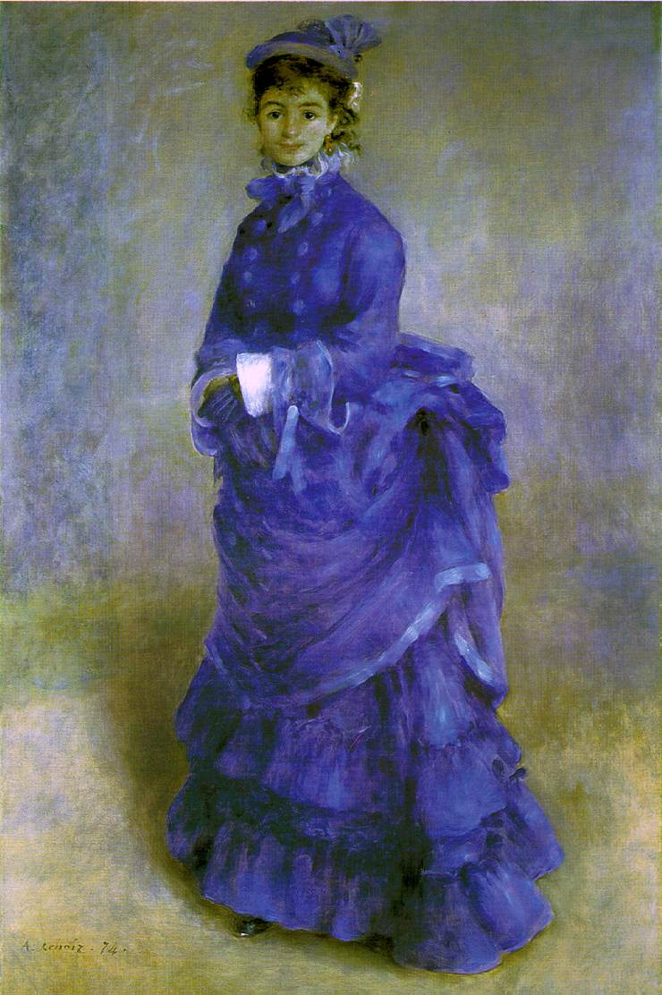
Pierre-Auguste Renoir “The Parisian” or “La Parisienne”

Slide 26
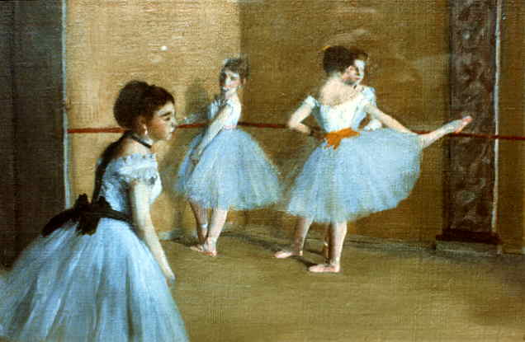
Edgar Degas “Dance Class at the Opera”

Slide 27
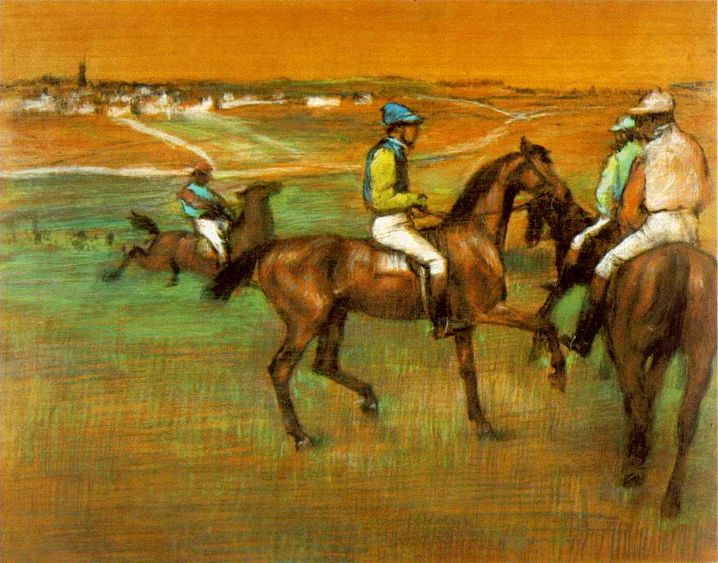
Edgar Degas “Race Horses”

Slide 28
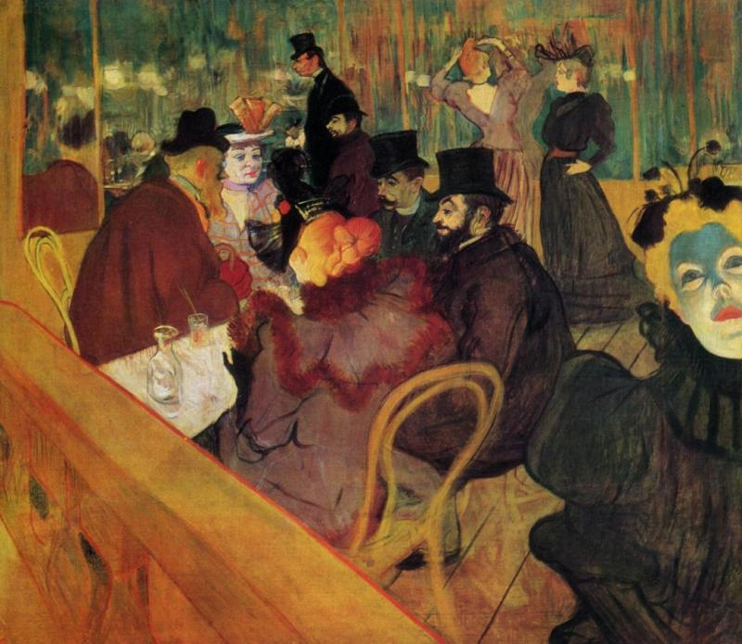
Henri de Toulouse Lautrec “Au Moulin Rouge”

Slide 29
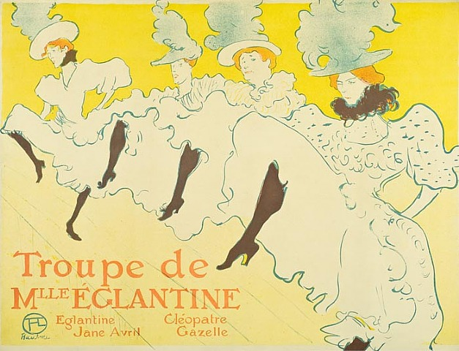
Henri de Toulouse Lautrec “Troupe de Mlle Eglantine”

Slide 30
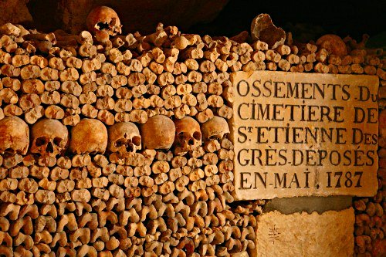
Les catacombes
In the 18th century certain Parisian cemeteries were too full, so they were emptied and the bones were put in the Paris underground.

Slide 31
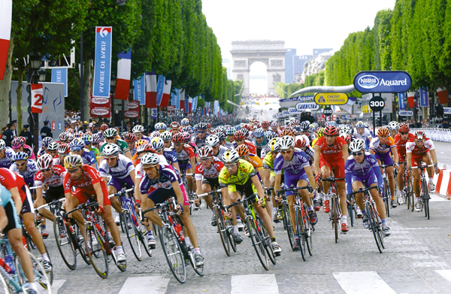
Le Tour de France
always ends on the Champs-Élysées in July.
Notes:
1. May be one of the greatest and most challenging sporting events in the world.
2. This cycling race takes place every year over three weeks in July, traveling through France and sometimes its neighboring countries.
3. Although the route changes every year, it always ends on the Champs-Élysées in Paris.

Slide 32
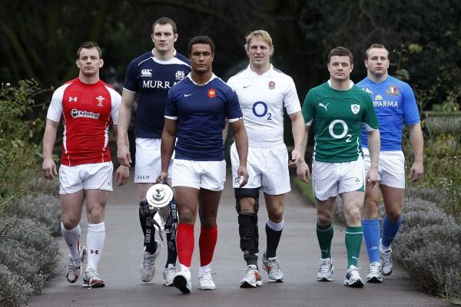
Le Tournoi des Six Nations
A rugby championship between teams from France, England, Scotland, Wales, Ireland, and Italy.

Slide 33
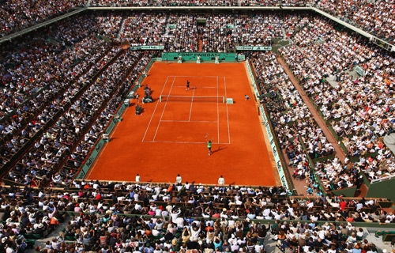
Les Internationaux de France
takes place every year at the Roland-Garros stadium. It’s a tennis tournament on a clay court. We know it as the French Open.

Slide 34
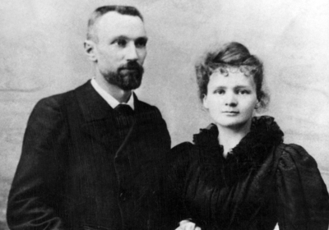
Marie et Pierre Curie
did research on radioactivity and discovered polonium and radium. They received the Nobel Prize in Physics in 1903.
Notes:
1. When they discovered radium, they almost immediately saw the possible impact this chemical element could have on medicine.
2. Not only did they find that radium gives off heat and light, but Pierre discovered that it could damage living organisms when he exposed it to his flesh.
3. This meant that new ways to treat cancer and other illnesses might be possible.

Slide 35
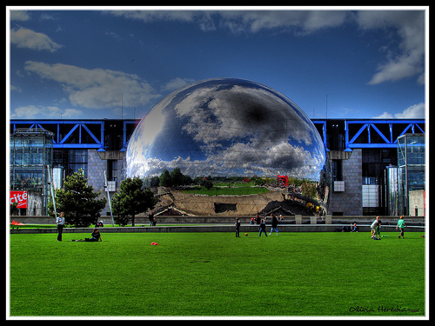
La Cité des Sciences et de l’Industrie
A museum devoted to the progress of technology.
Notes:
1. Opened in 1986 and has welcomed over 40 million visitors.
2. This popular science park consists of several museums and theaters where visitors can engage in interactive activities related to all aspects of science and technology.
3. Exhibits and films have ranged from the exploration of space and how the brain works to the science of Jules Verne and the digital age.

Slide 36
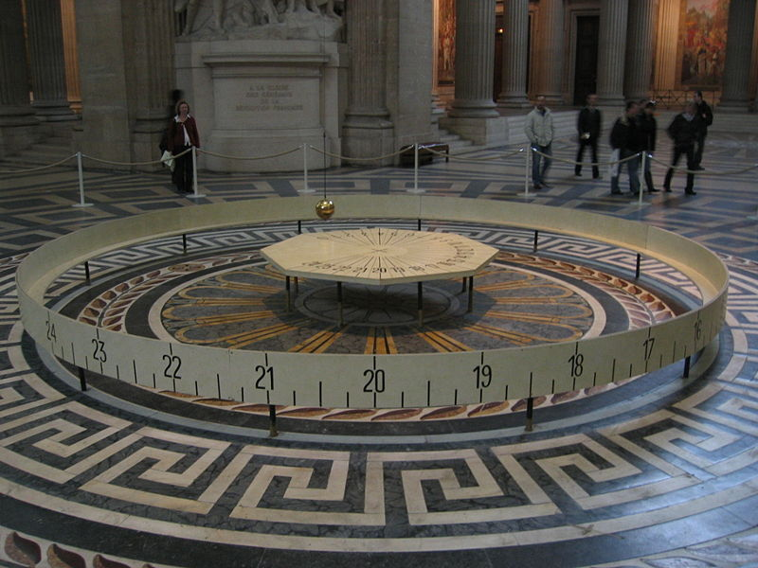
La pendule de Foucault
In 1851, physicist Léon Foucault created this pendulum to show the rotation of the earth on its axis.

Slide 37
La haute cuisine française
Paris symbolizes high-class French cooking which is known throughout the entire world.

Slide 38
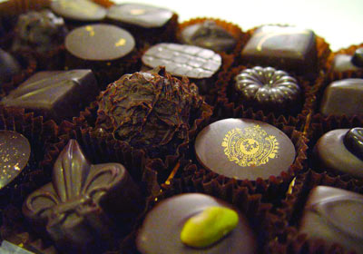
Les chocolatiers de Paris
mix chocolate with spices, fruit, and even flowers to create new flavors.

Slide 39
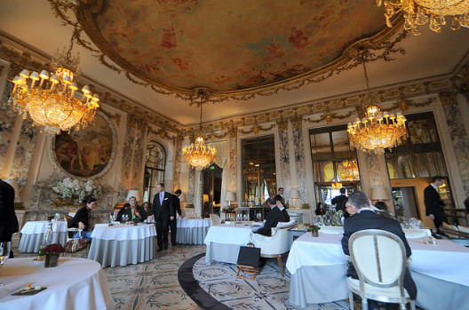
Les restaurants parisiens
Every year the best chefs receive “stars” for the quality of their cooking, with a maximum of three stars.
There are several “three star” restaurants in Paris.

Slide 40
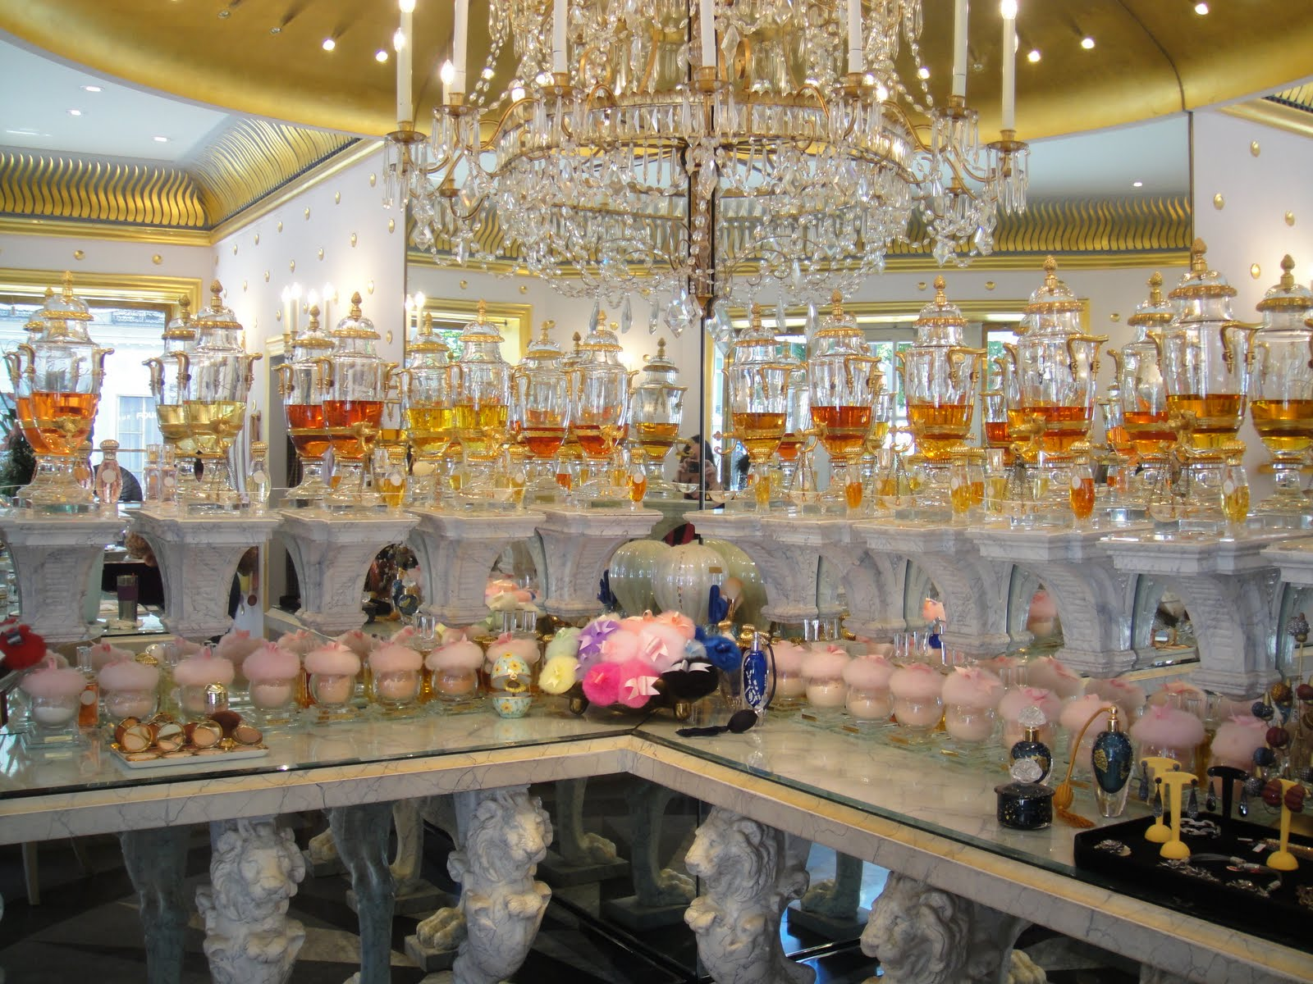
Les magasins de luxe
With its perfume shops, its leather goods shops, and other specialty shops, Paris is the ideal city for shopping!

Slide 41
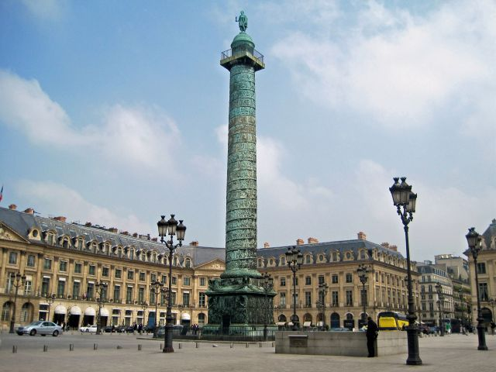
Les grands bijoutiers
A lot of famous jewelers have stores in Vendôme square, in Paris.

Slide 42
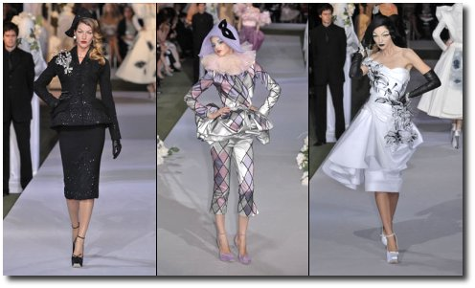
La haute couture
Paris is the capital of haute couture.
The big designers present their collections there twice a year, in the spring and in the fall.
Notes:
1. Fashion and luxury goods make up an important sector of the French economy. These high-value items include clothes, cosmetics, perfume, jewelry, furs, and leather goods.
2. Industries producing these goods bring in over 28 billion euros in revenue annually and employ over 234,000 people. Many of them are headquartered in Paris.

