Slide 1
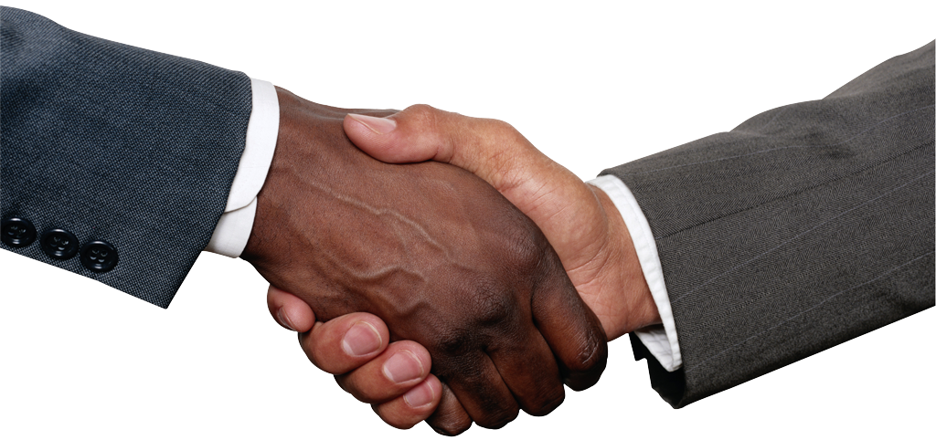
Greetings and Basic Phrases

Slide 2
Greetings
Salut – Hello, Goodbye (informal, used between young people)
Bonjour – Hello, Good day (also used as good morning or good afternoon)
Bonsoir – Good evening
Enchanté(e) – Very nice to meet you.

Slide 3
Titles
Monsieur (M.) – Mister (Mr.)
Madame (Mme) – Ma’am (Mrs.) (used for married or older women)
Mademoiselle (Mlle) – Miss (Ms.) (used for unmarried or younger women)

Slide 4
To say goodbye
Au revoir – Goodbye
À bientôt – See you soon
À demain – See you tomorrow
À plus tard – See you later
À toute à l’heure – See you later
Adieu – Goodbye, Farewell (formal)
Bonne nuit – Good night

Slide 5
To ask someone’s name
Comment tu t’appelles? – What is your name? (informal)
Je m’appelle _______. – My name is ________.
Comment il / elle s’appelle? – What is his / her name?
Il / Elle s’appelle ________. – His / Her name is _________.

Slide 6
To ask how someone is
Comment ça va? – How are you? (informal)
Ça va? – How are you? (informal)
Comment vas-tu? – How are you? (informal)
Comment allez-vous? – How are you? (formal)
Et toi? – And you? (informal)
Et vous? – And you? (formal)

Slide 7
To respond
Ça va (bien). – Fine.
Bien / Très bien, merci. – Fine / Very good, thank you.
Pas mal. – Not bad.
Plus ou moins. – So-so.
Pas très bien. – Not too good.

Slide 8
Introductions
Je te présente... – I’d like to introduce you to...
Je vous présente... – I’d like to introduce you to...
Ça, c’est Youssef/Marie – This is Youssef/Marie.
C’est un ami/une amie – He/She is a friend.

Slide 9
Expressing Manners
S’il te plaît – Please (informal)
S’il vous plaît – Please (formal)
Merci – Thank you
De rien – You’re welcome

