Slide 1
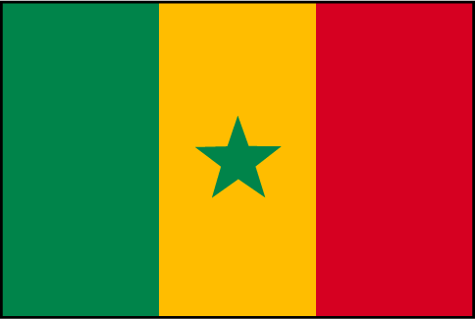
French 1 Chapitres 7-8
Géoculture – Le Sénégal

Slide 2
Almanac
Population: more than 11 million people
Major cities: Dakar, Thiès, Saint-Louis, Kaolack, Touba
Industries: agriculture, fishing, oil trade, refinery
Senegal has twelve national or official languages: Balanta-Ganja, Hassaniyya, Jola-Fonyi, Mandinka, Mandjak, Mankanya, Noon, Pulaar, Serer-Sine, Soninke, Wolof, and French.

Slide 3
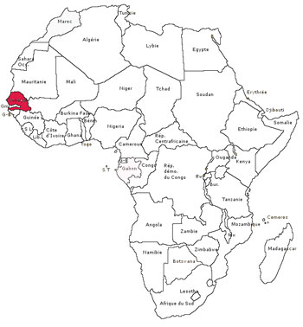

Slide 4
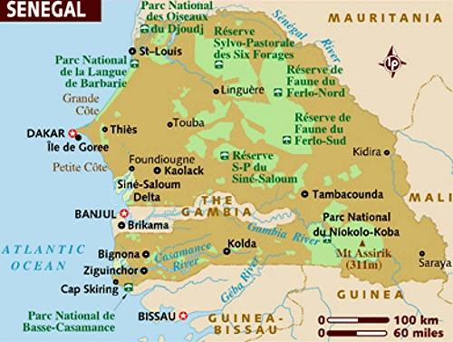

Slide 5
Geography
Senegal is located on Africa’s westernmost point, on the Cap Vert peninsula.
Gambia (La Gambie) is a separate nation, surrounded by Senegal on three sides. It almost divides Senegal into two parts.
In 1982, Senegal and Gambia briefly formed a confederation, called la Sénégambie, but integration of the two countries was never fully realized, and in 1989, the union was dissolved.

Slide 6
History
Archaeological findings throughout Senegal indicate that it has been inhabited since prehistoric times.
In the 11th century, Islam was established in Senegal.
In the 16th century, the country was divided into four kingdoms: Jolof, Walo, Cajor (Kajor), and Bawol (Baol).

Slide 7
History
Starting in the 15th century, various European powers controlled Senegal, including the Dutch, the English, and the Portuguese, before the French gained possession.
In 1960, Senegal gained its independence from France.
That same year, acclaimed poet Léopold Senghor became the country’s first president.

Slide 8
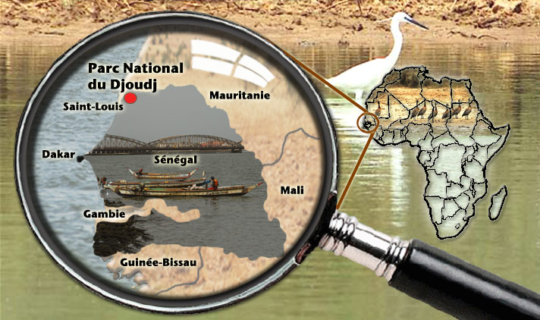

Slide 9
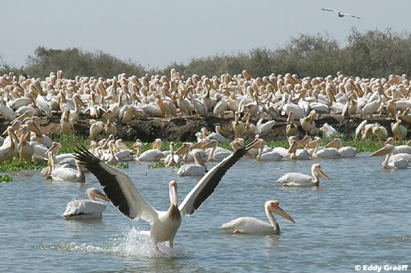
Le parc national du Djoudj
A large ornithological (bird) reserve
A lot of birds stop there during their migration.

Slide 10
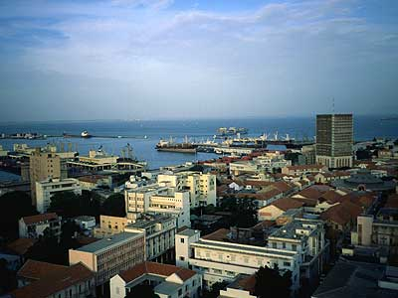
Dakar
Dakar is the capital of Senegal, and the most occidental (westernmost) point of the African continent.
The name Dakar came from the Wolof word dakhar, meaning tamarind tree.

Slide 11
Les baobabs
Enormous trees that don’t have any leaves for 9 months out of the year.
The fruit of the baobab tree is called « pain du singe » or monkey bread.
The baobab tree is the emblem of Senegal.
Its trunk can reach 9 meters (27 feet) in diameter and it can live more than 1,000 years.

Slide 12
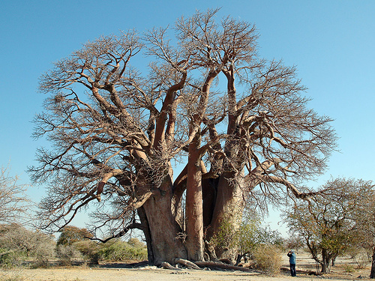

Slide 13
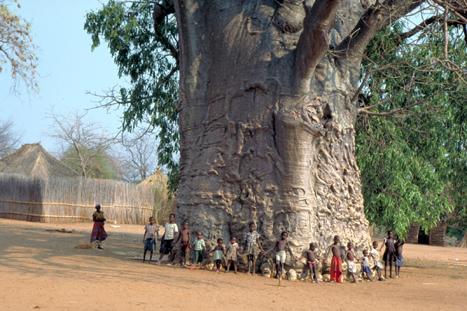

Slide 14
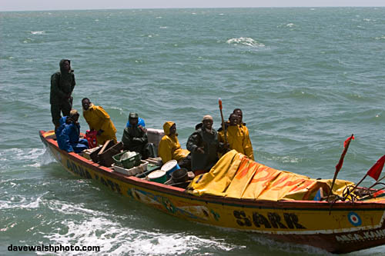
La pêche - Fishing
An important resource for the Senegalese
(les Sénégalais).

Slide 15
La Casamance
A region of mangroves (swamps), rivers, and plantations.
It’s the part of Senegal located south of Gambia.
Unlike the rest of Senegal, la Casamance has lush forests, rice paddies, and giant kapok trees, which can grow 150 feet tall.
The beaches of la Casamance are considered the best in West Africa.
Sunny days, the warm sea, and miles of sandy beaches make this region a popular vacation destination.

Slide 16
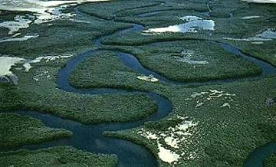

Slide 17
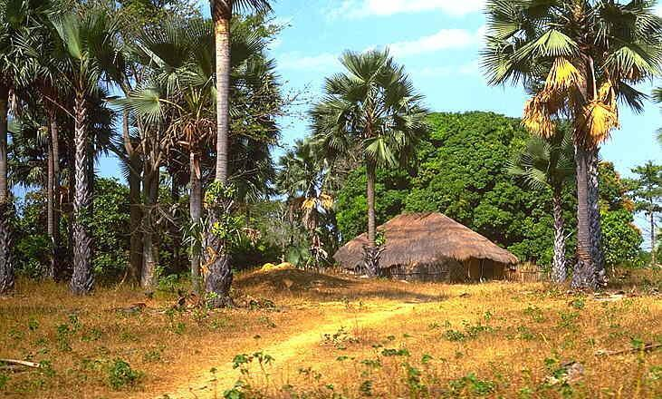

Slide 18
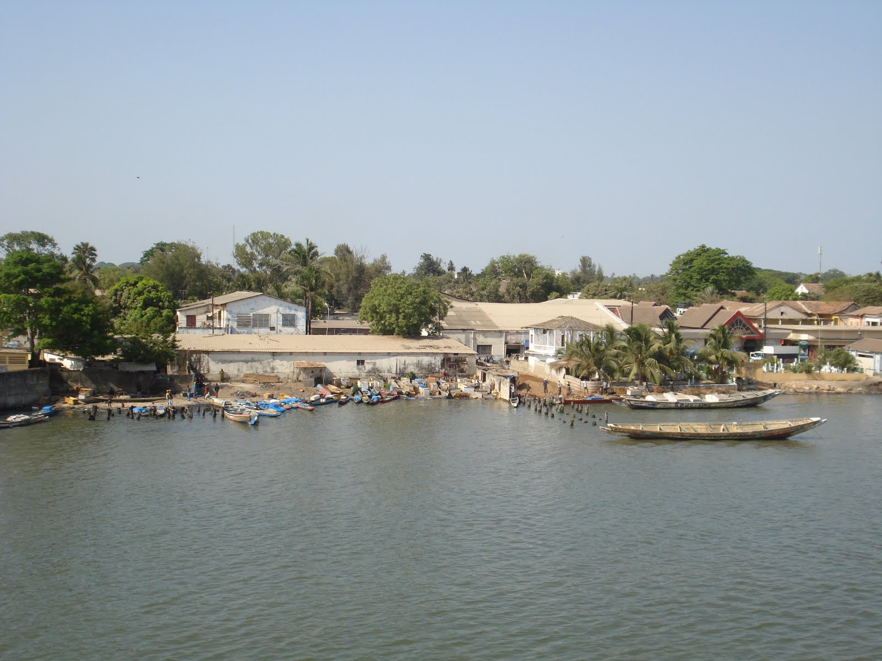

Slide 19
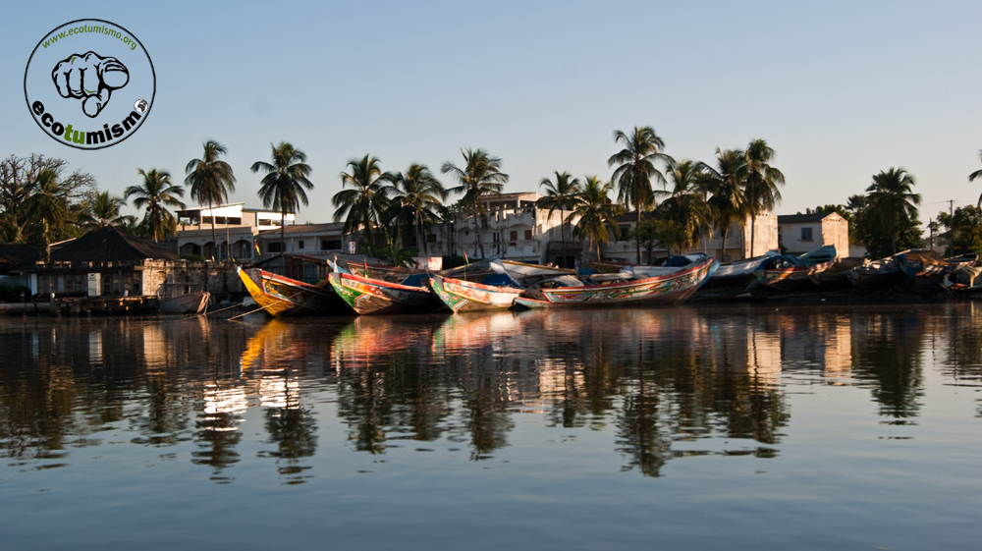

Slide 20
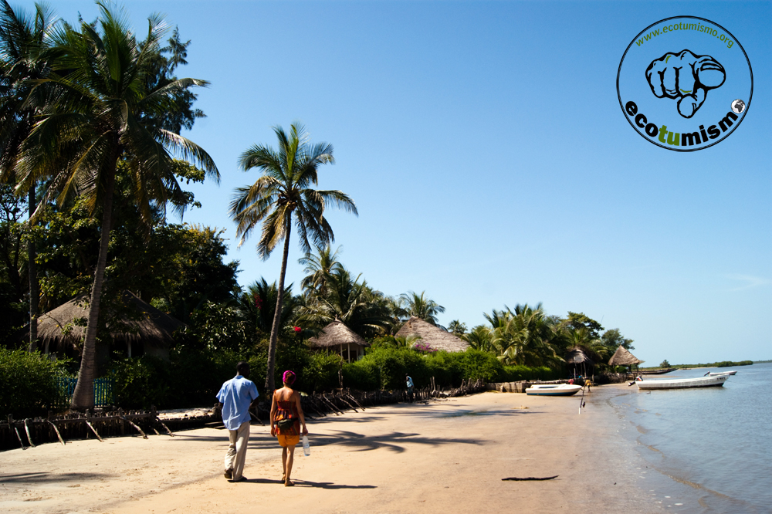

Slide 21
Le lac Retba
Le lac Retba or lac Rose (Pink lake) owes its color to the micro-organisms and the salt that it contains.
Due to its high salinity, objects float on it.

Slide 22
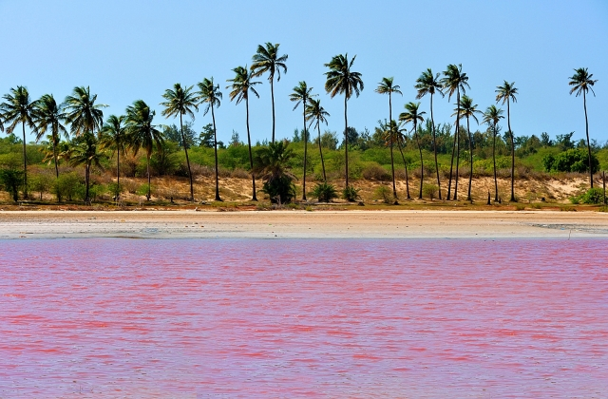

Slide 23
Saint-Louis
The oldest French city in West Africa
The first capital of Senegal
The Faidherbe bridge, built by Gustave Eiffel, connects Saint-Louis to the continent.

Slide 24
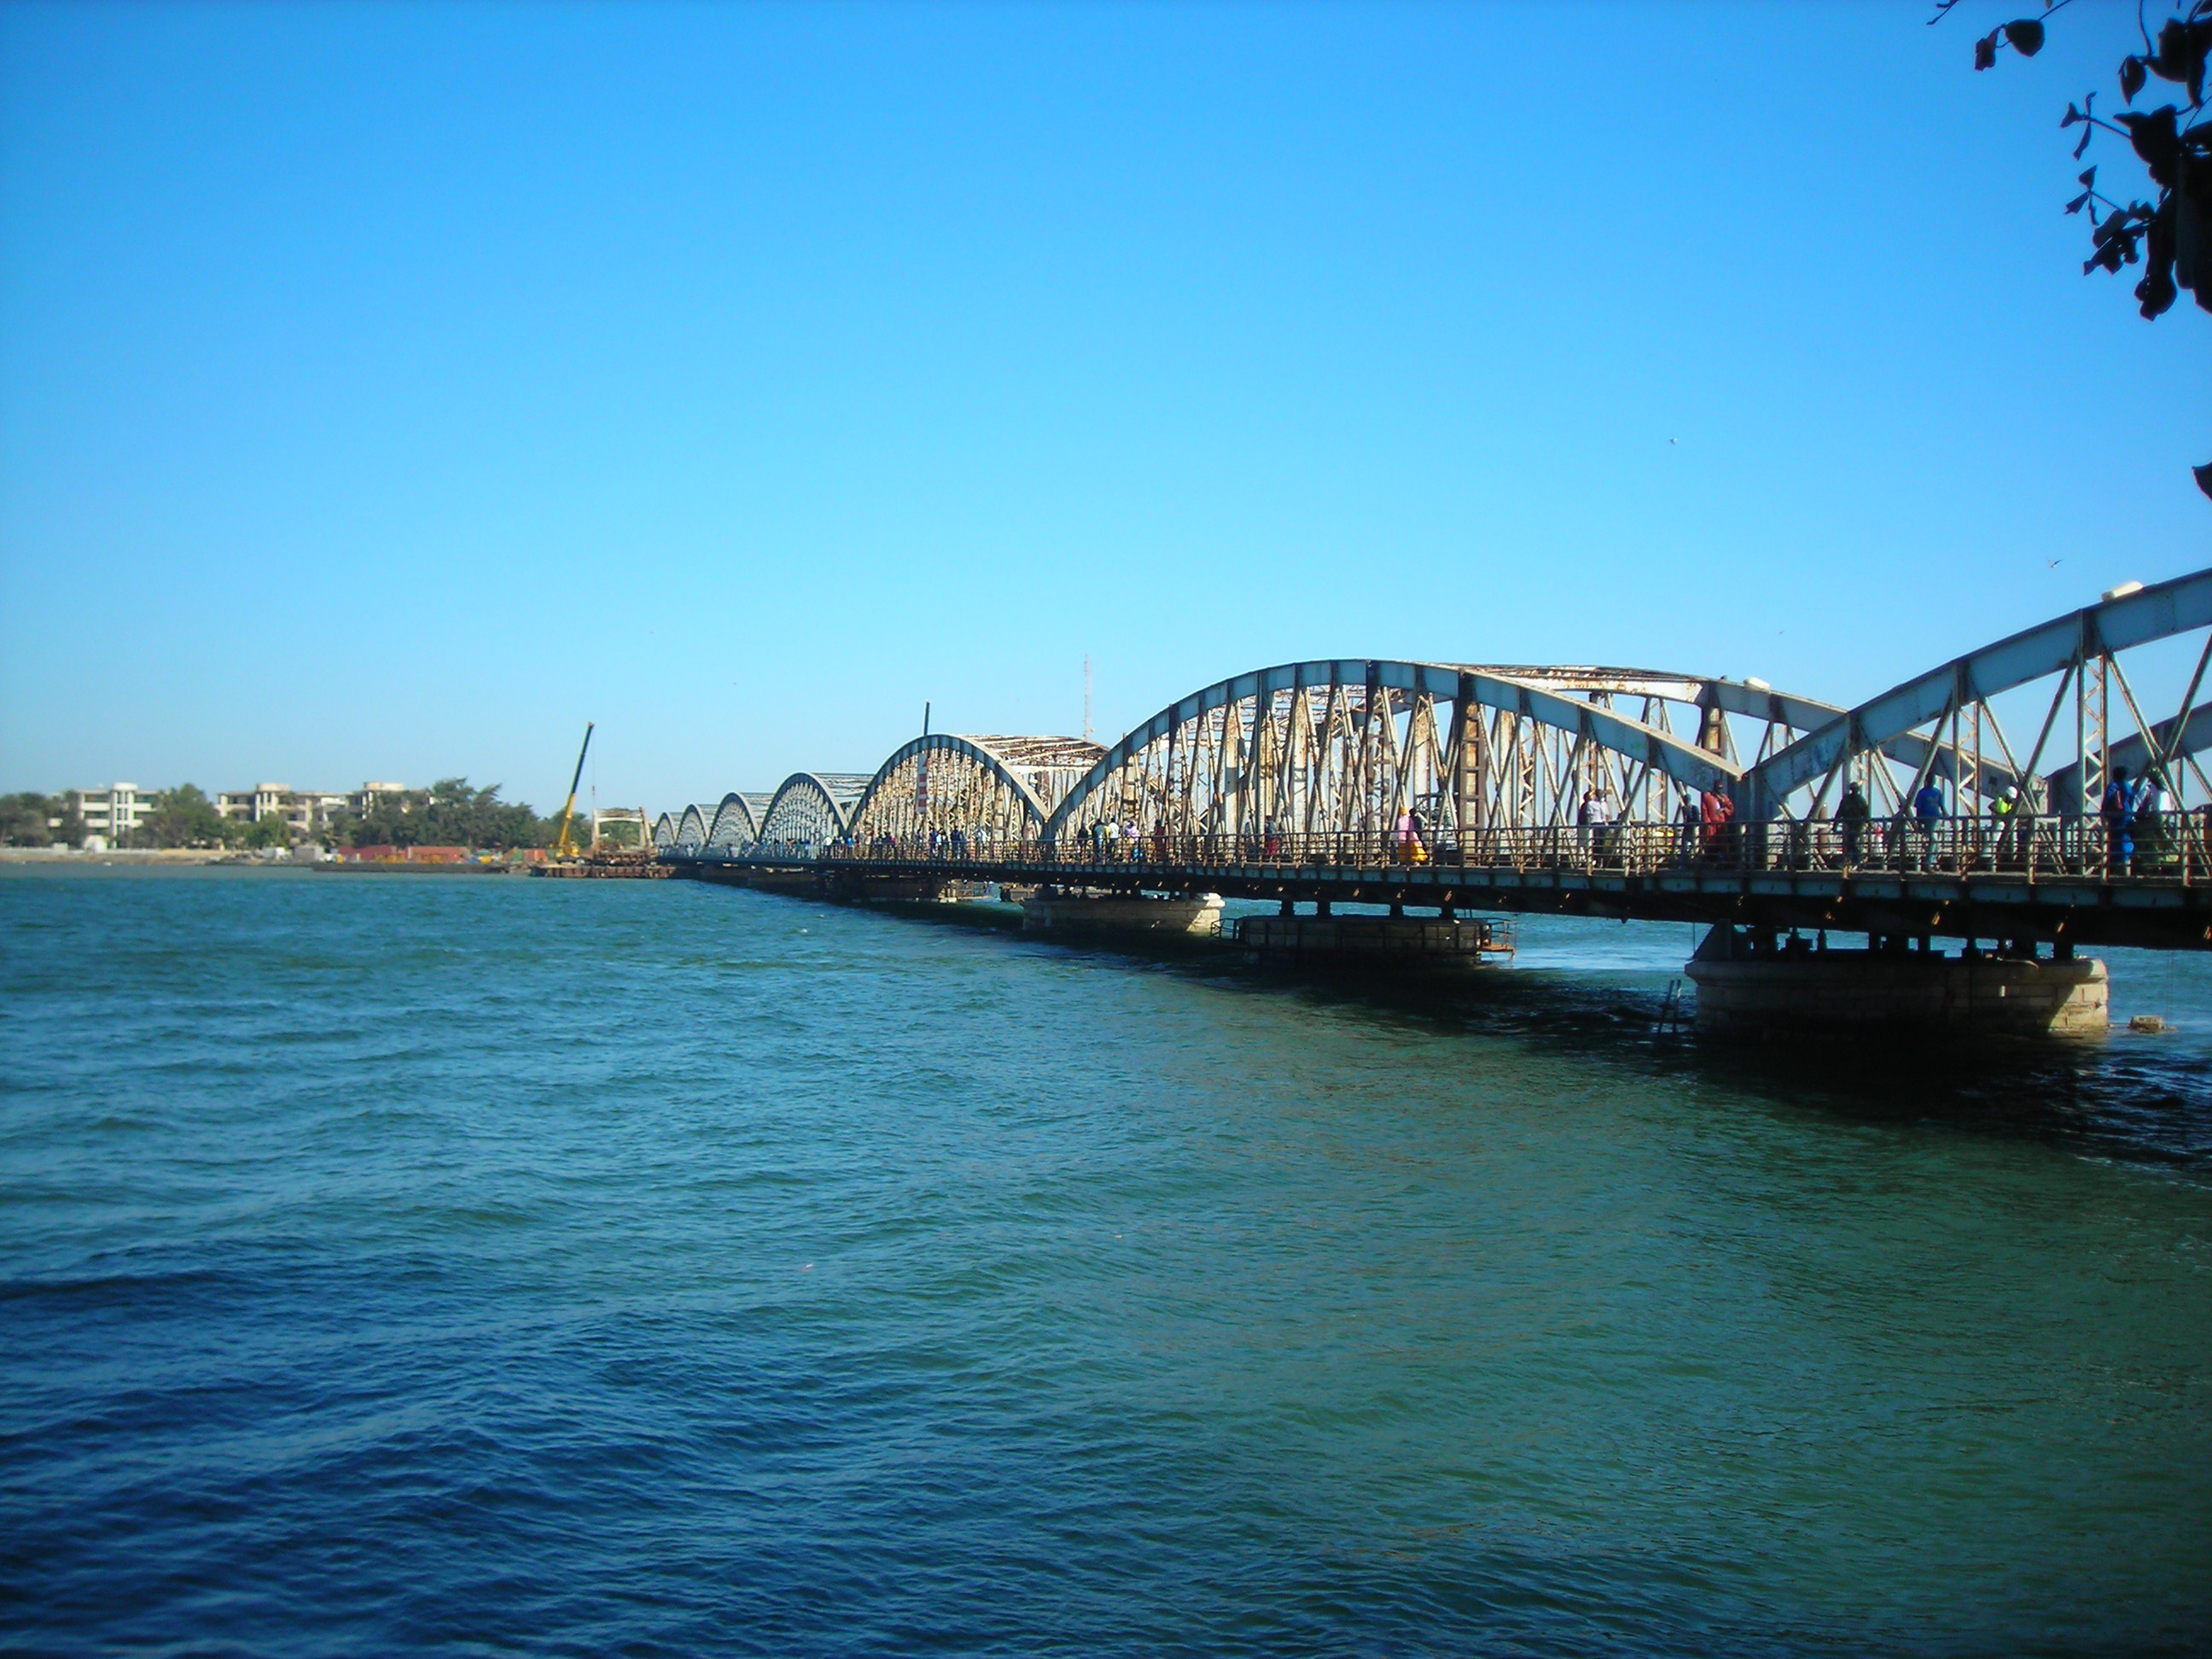
Le pont Faidherbe

Slide 25
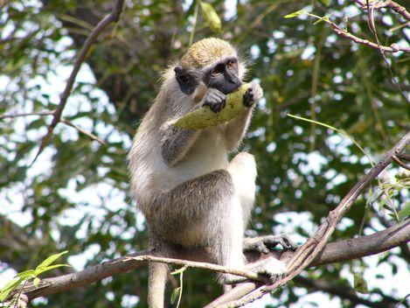
Le parc national du Niokolo Koba
The purpose of the park is to protect animals threatened with extinction, like the chimpanzee and the panther.

Slide 26
Le parc national du Niokolo Koba
The largest of Senegal’s national parks, it covers over 2 million acres.
It protects all sorts of wildlife, including lions, elephants, antelope, monkeys, crocodiles, hippopotami, and 300 species of birds, although big game hunting is permitted outside of the park.

Slide 27
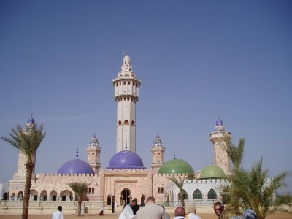
La mosquée de Touba
The Touba Mosque is a very important religious center.
A number of pilgrims go there every year.

Slide 28
L’île de Gorée
Less than 2 miles from Dakar
UNESCO World Heritage site and former slaving station
Today, the island and its museums offer a glimpse into the nation’s past and insight into its present.
The Maison des esclaves is both a reminder of the shame of human exploitation and a place for reconciliation.

Slide 29
L’île de Gorée
The Musée de la mer is concerned with all aspects of the sea, including marine life, seafaring vessels, and fisherman and their tools.
The Musée de la femme is a museum devoted to Senegalese women.

Slide 30
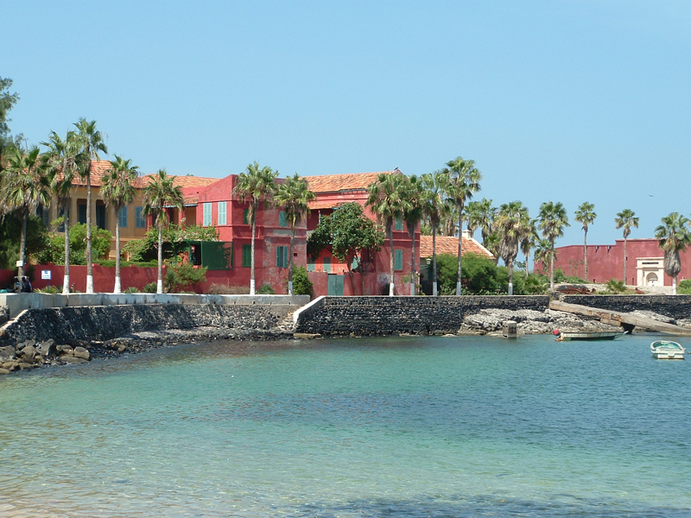

Slide 31
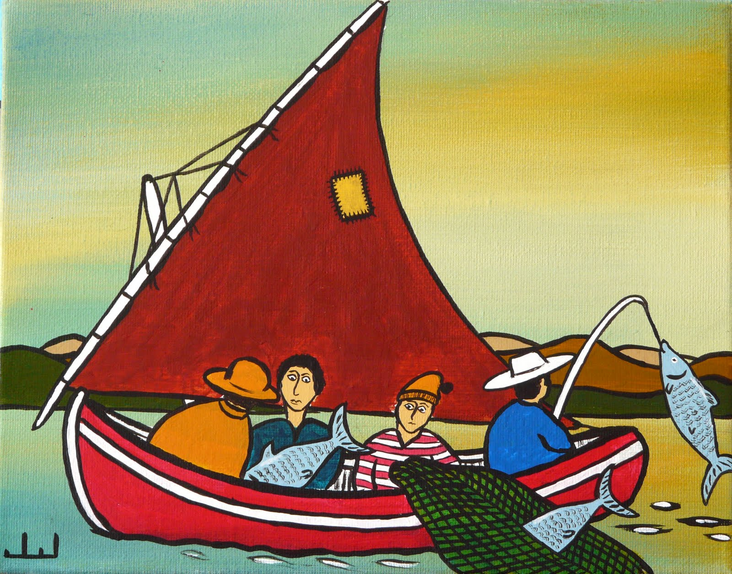
Les souwères
Paintings under glass that represent scenes from daily life and historic national heroes.

Slide 32
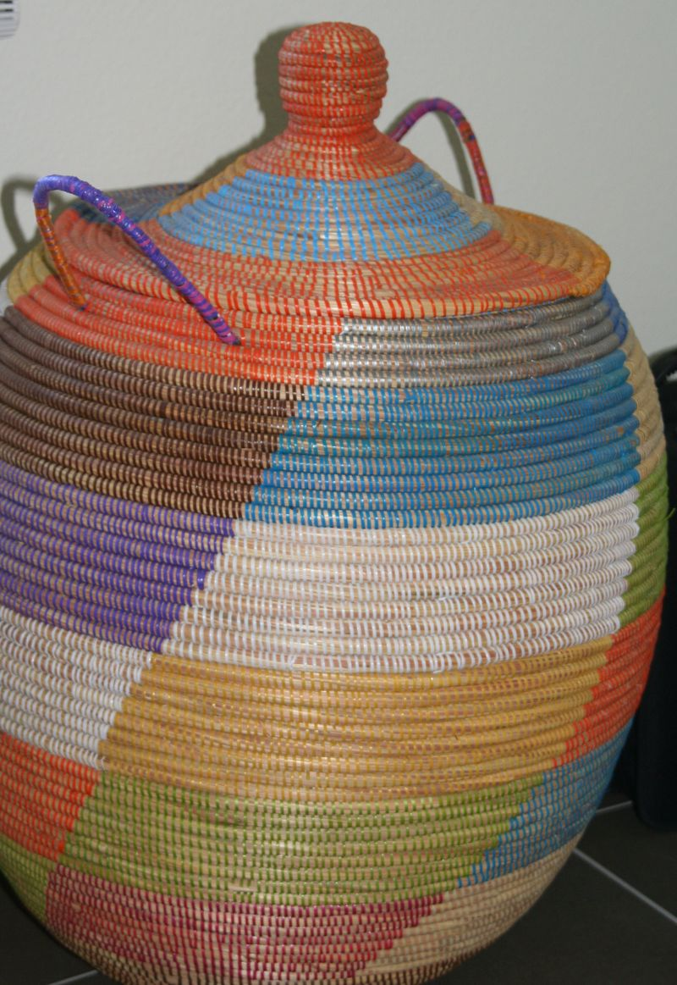
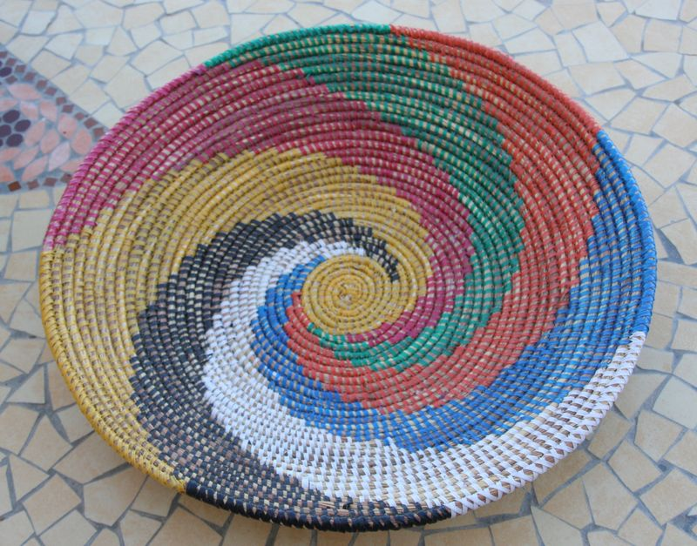
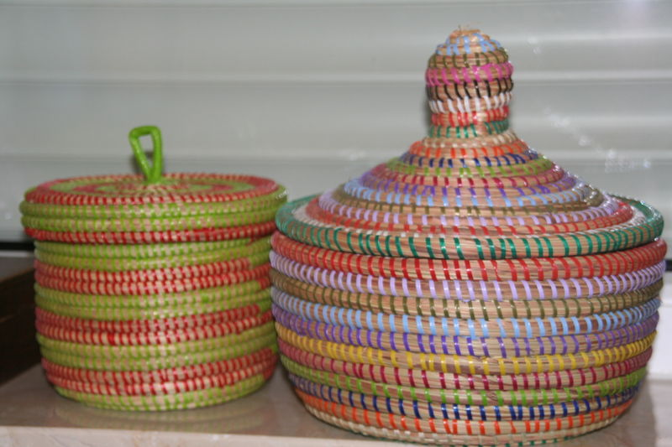
La vannerie – Basket-making
Artisans use recycled materials to make different wicker objects.

Slide 33
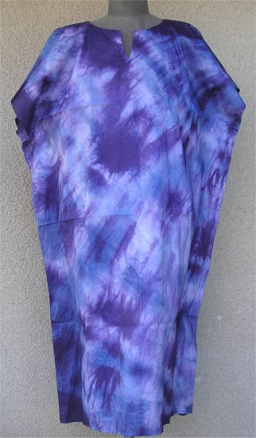
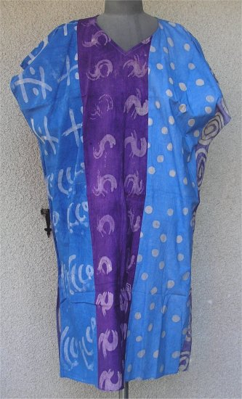
Le batik
Batik is an artisanal technique used to decorate traditional clothes, like les boubous.

Slide 34
Artisans
In addition to la vannerie, les souwères, and les batiks, Senegalese artisans make sand paintings from black, ochre, red, white, and grey sands, gathered from all regions of Senegal.
Other handcrafts include gold and silver jewelry, hand-woven fabrics, leather goods, pottery, and wood carvings.
To see a variety of Senegalese arts and crafts, one can visit le village artisanal Soumbédioune outside of Dakar.

Slide 35
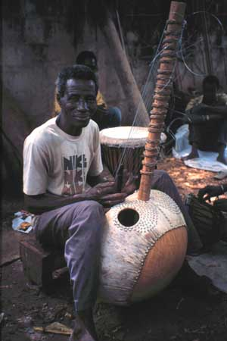
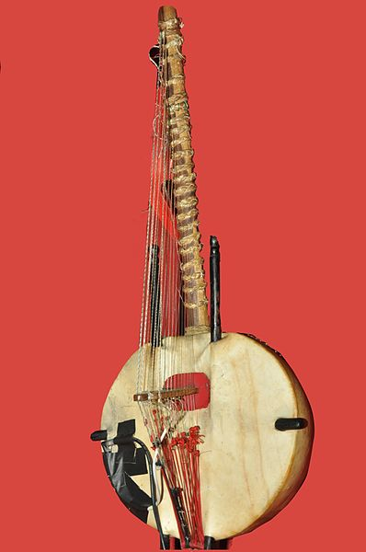
La musique traditionelle
Each ethnic group has its own music.
The kora is one of the instruments of traditional music.

Slide 36
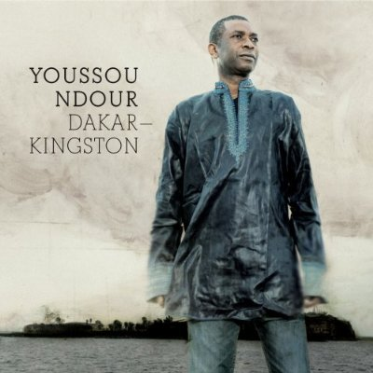
Le mbalax
Mbalax is a type of music that mixes rhythms and traditional instruments from Senegal with salsa, rock, and funk.
Youssou N’Dour has made this type of music known throughout the world.

Slide 37
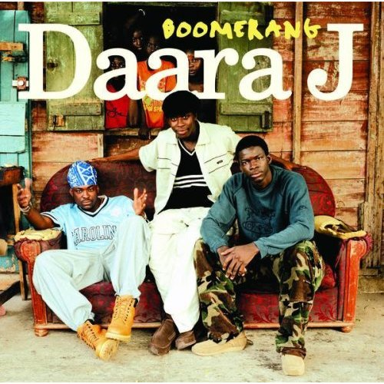
Le groupe Daara J
Daara J is a group who sings Senegalese rap, or Séné-rap.
Their songs talk about the environment and daily life.

Slide 38
La musique
The songs of Séné-rap and mbalax are often sung in Wolof, the most spoken traditional language in Senegal.

Slide 39
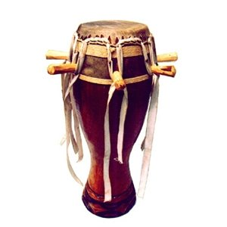
La musique
One common Senegalese musical instrument is a drum, called a sabar.
The word mbalax comes from a family of traditional sabar dance rhythms.

Slide 40
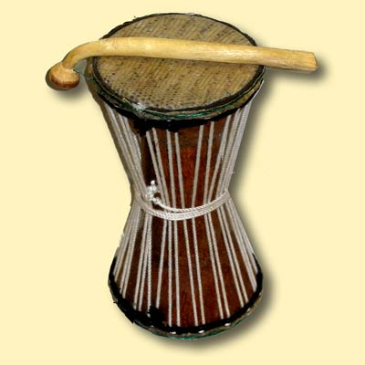
La musique
The tama is called a “talking drum”, because its pitch can be regulated.

Slide 41
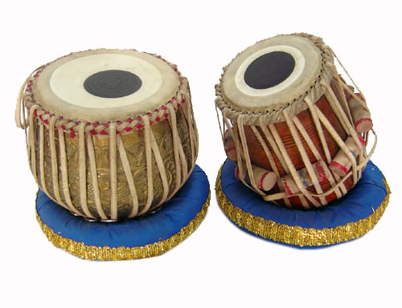
La musique
The tabala is a set of wooden kettle drums.

Slide 42
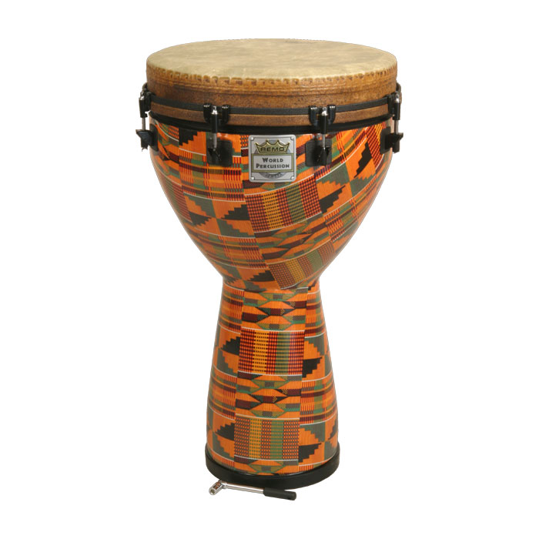
La musique
The djembe is a goblet-shaped drum.

Slide 43
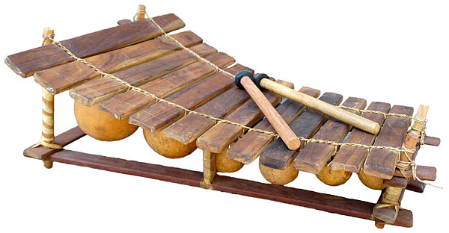
La musique
The balafon is both percussive and melodic, with wooden slats that are struck with mallets.

Slide 44
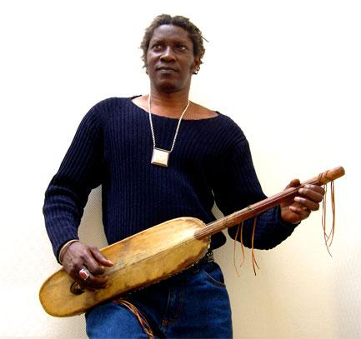
La musique
The xalam is a string instrument with a nasal sound.

Slide 45
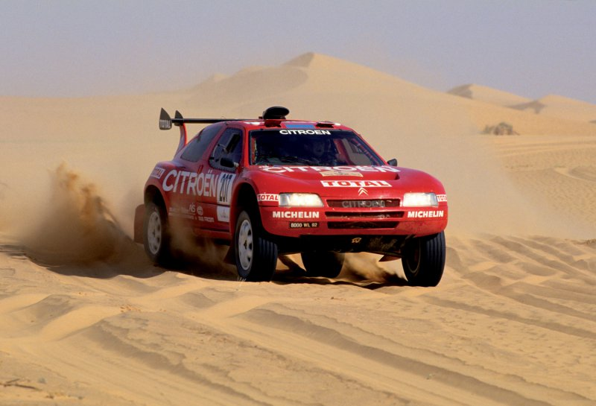
Le Dakar
Off-track race that leaves from Europe and ends in Dakar
There are three different categories: motorcycles, cars, and trucks.

Slide 46
La lutte sénégalaise – Senegalese wrestling
Traditional sport in Senegal
To win a match, the shoulder, back, or knees of the opponent must touch the ground.
Wrestling has been popular in Senegal for centuries. Its champions are considered heroes.
Most wrestlers are observers of the Animist faith.

Slide 47
La lutte sénégalaise – Senegalese wrestling
La luttle Sénégalaise is a combination of sport, dance, and folklore.
Before contestants enter the arena, women sing their praises and musicians play traditional drums.
The wrestlers enter wearing loincloths. Their bodies are then smeared with powders. They are given amulets and holy water. The preparations usually last longer than the fight itself.

Slide 48
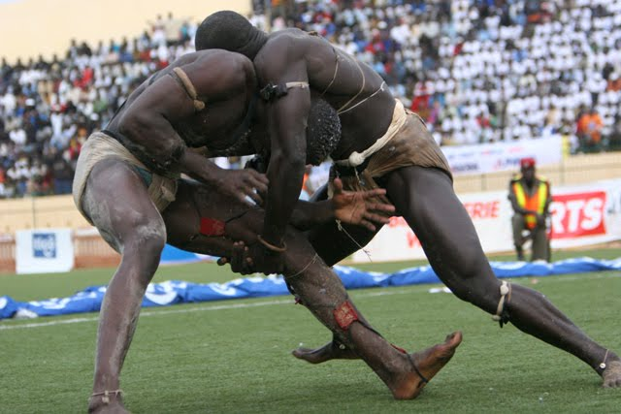

Slide 49
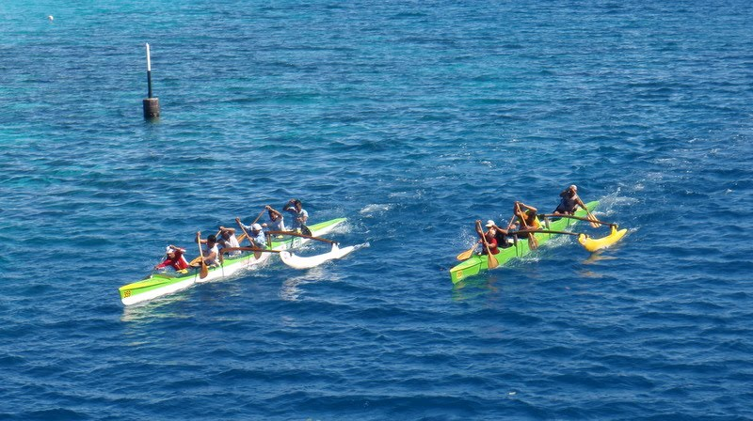
Les courses de pirogues
The fishermen use their pirogues to participate in races in the sea and on the rivers of the country.

Slide 50
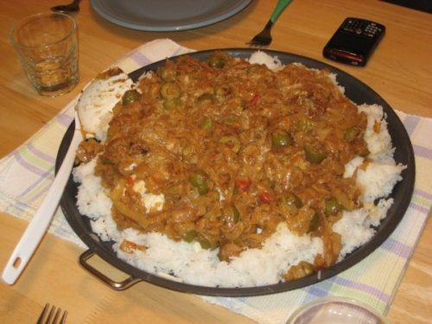
Le poulet yassa
A traditional dish made of chicken marinated in citrus juice and onions cooked in peanut oil.

Slide 51
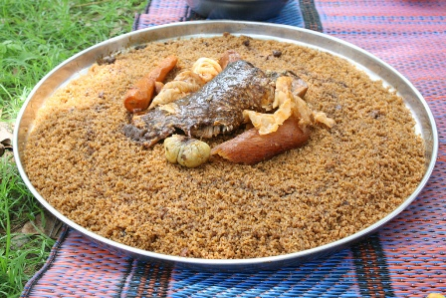
La tieboudienne
Another typical dish from Senegal made of fish, rice, and vegetables.

Slide 52
La gastronomie
When dining in a Senegalese home, it is customary to pour water over your hands as you enter the dining area and then dry them on a common cloth.
Food is served in bowls, each containing enough for three or four people.
The main course is typically a stew, such as la tieboudienne, which is eaten with the first three fingers of the right hand.
Dessert is usually fruit, followed by coffee and tea.

Slide 53
Politics
The Senegalese president holds a great deal of power.
Presidential elections are held every five years through universal adult suffrage.
Approximately 65 political parties are active in Senegal.

