Slide 1
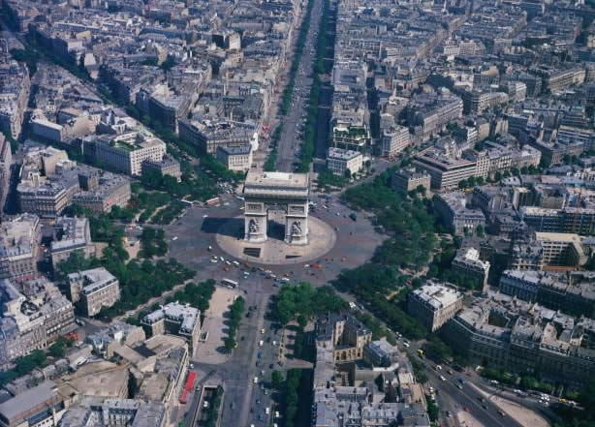
French 1 Chapitre 1
Géoculture – l’Île-de-France

Slide 2
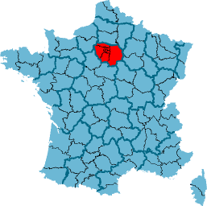
L’Île-de-France

Slide 3
Almanac
Population: Over 11 million (20% of France’s population)
Cities: Paris, Meaux, Versailles, Melun, Chartres, Giverny
Industries: Tourism, Construction

Slide 4
Geography
The Seine flows through the heart of Paris.
The southern half of the city lies to the left of the river when facing downstream and is called la rive gauche (Left Bank).
The area to the right is called la rive droite (Right Bank).
At the center are two islands, L’Île de la Cité and l’Île St-Louis.
Notes:
Paris itself is only about 105 square kilometers (41 square miles) in size. New York City is approximately 321 square miles in size.

Slide 5
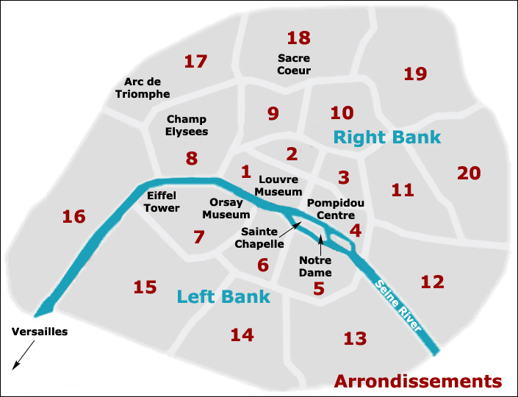

Slide 6
History - Paris
The city of Paris developed from L’Île de la Cité, originally a tiny fishing village prone to flooding.
In 52 B.C., the island fell under Roman control.
The Romans called the city Lutecia, meaning marshy place.
Their settlement flourished and eventually spread into the outlying areas.

Slide 7
History – L’Île-de-France
The original name of L’Île-de-France was Pays de France.
The meaning of the word pays evolved to mean nation or country, so the name was changed around 1387.
L’île means island, and this region of France is surrounded by several rivers (Oise, Seine, Marne, and Ourcq).

Slide 8
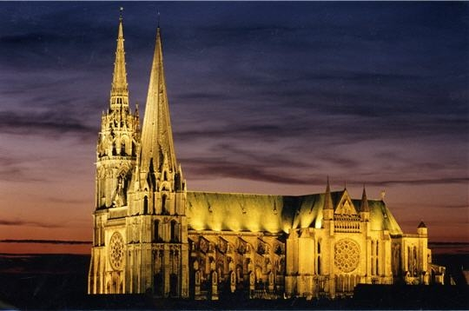
Notre Dame de Chartres
Located just outside Île-de-France, Chartres’ cathedral is known for its architectural style and its remarkable stained-glass windows.

Slide 9
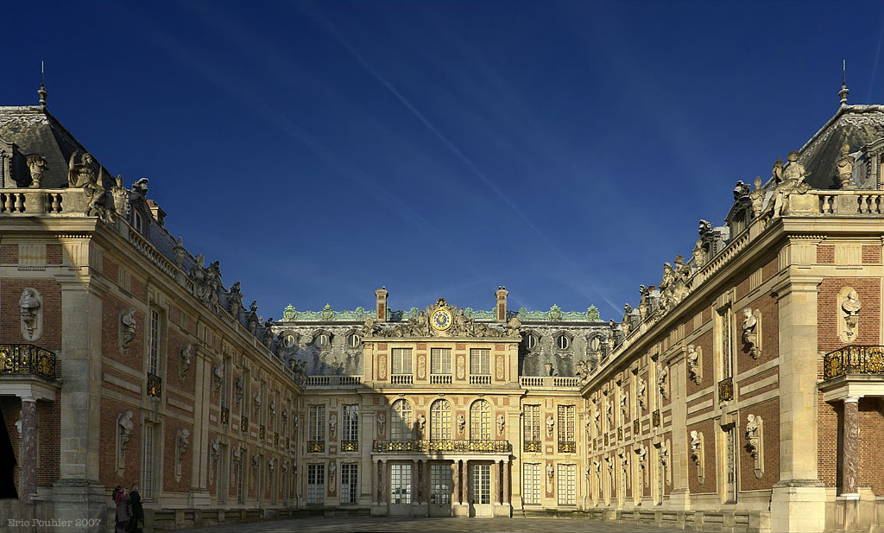
Versailles
In 1682, Louis XIV moved the royal court from Paris to Versailles.

Slide 10
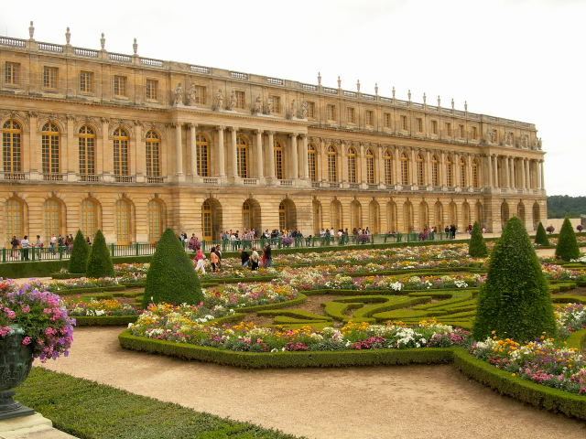
Versailles

Slide 11
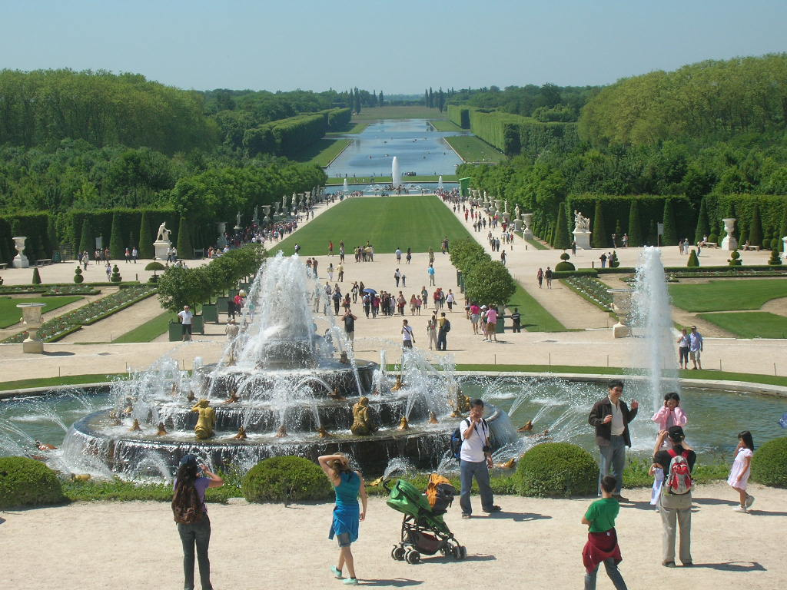
Versailles

Slide 12
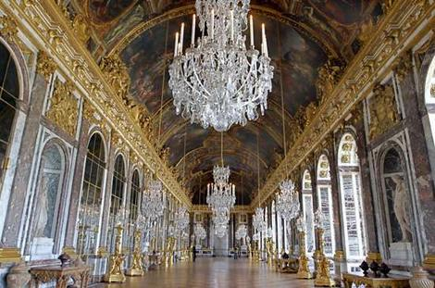
La galerie des Glaces (The Hall of Mirrors)
This 73-meter room, decorated with mirrors, is one of the main attractions of the palace.

Slide 13
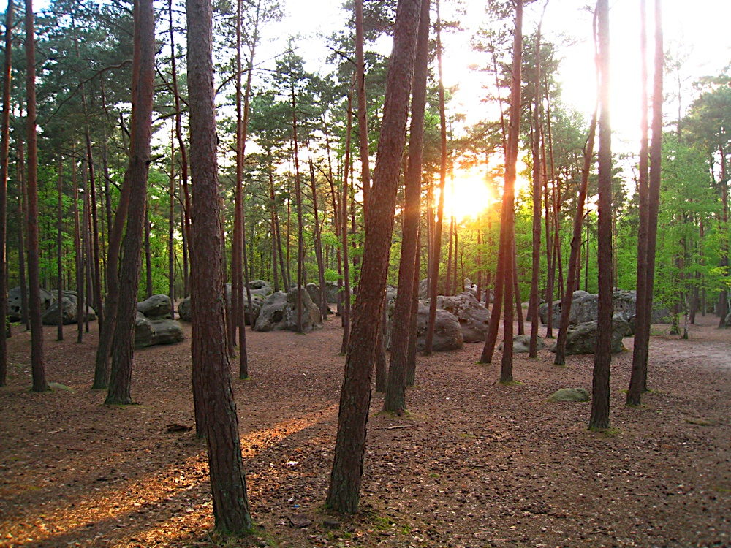
Fontainebleau
This forest is popular for cycling, rock climbing, and horseback riding.

Slide 14
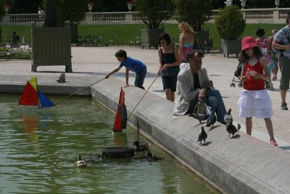
Le jardin du Luxembourg
Kids enjoying sailing boats in the pond of this popular Parisian park.

Slide 15
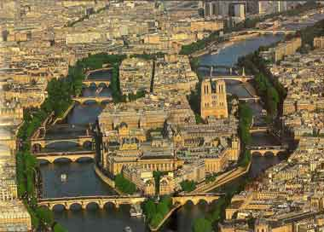
L’Île de la Cité
This island, in the middle of the Seine river, is known as the “cradle of Paris.”

Slide 16
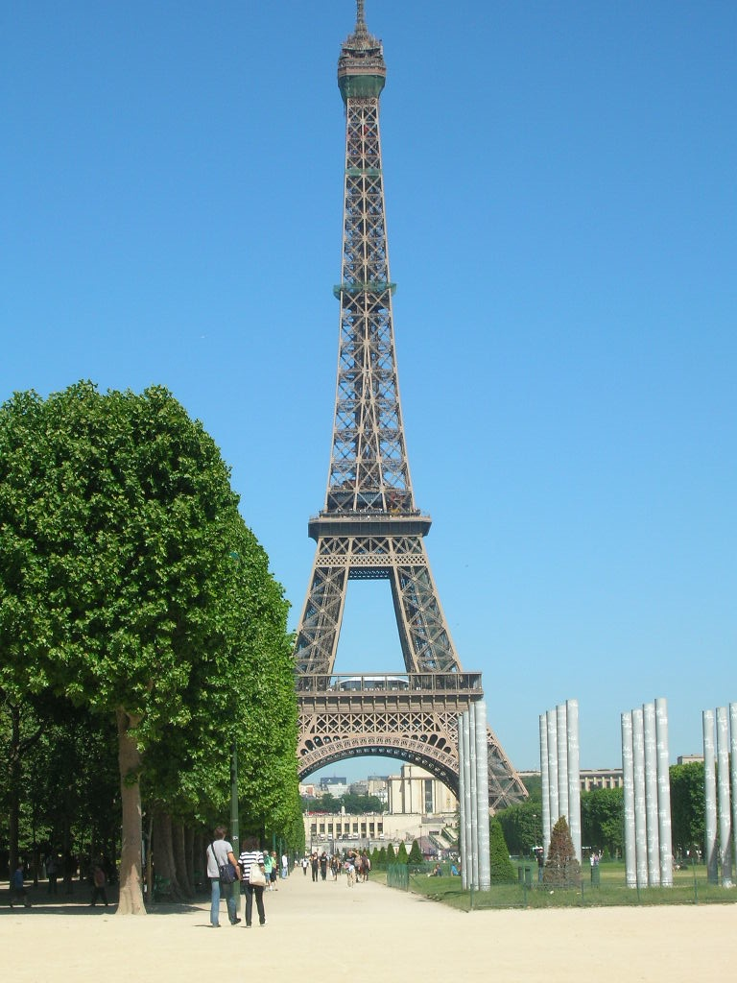
La tour Eiffel
This Parisian monument was the tallest in the world when it was built in 1889.
Notes:
- The total elevation of the Eiffel Tower is 1,056 feet, including the base and television antenna on top.
- To reach the third level, one must climb 1,710 steps or take the elevator.

Slide 17
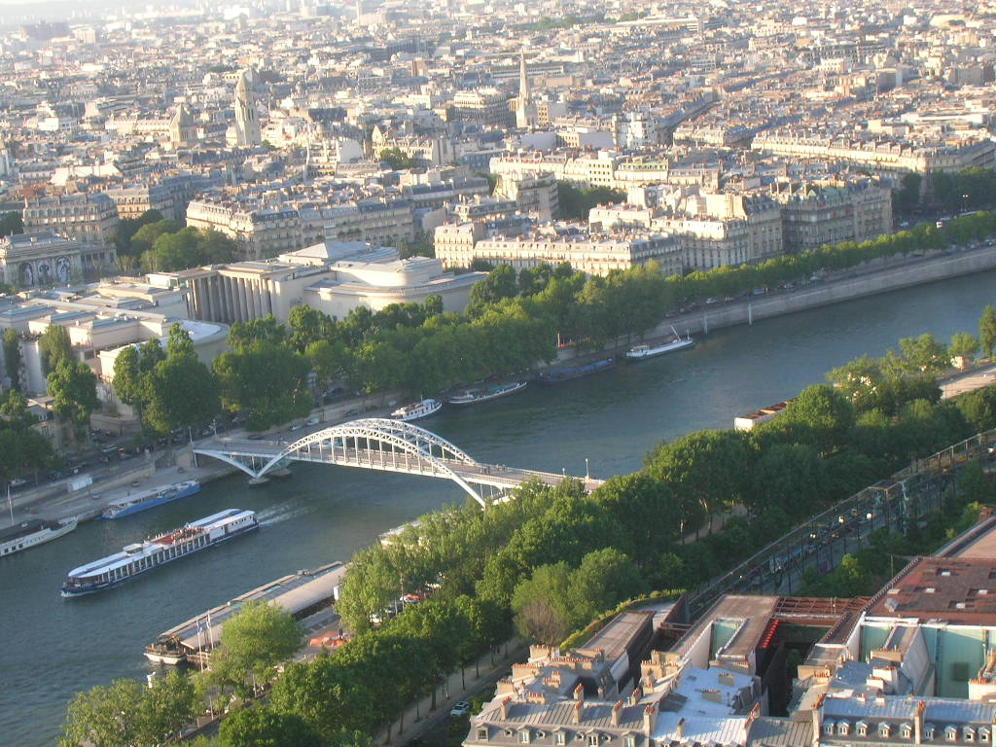
La Seine
This river runs through Paris. It is the second longest river in France.

Slide 18
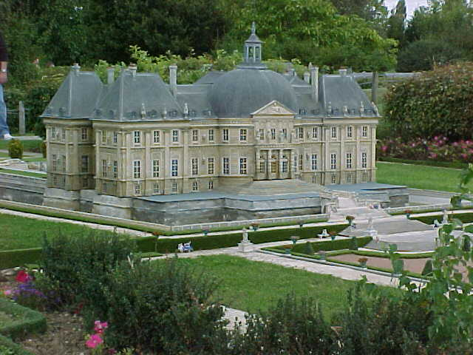
Le château de Vaux-le-Vicomte
This chateau, located near Melun, is known for its beautiful garden in a classic style called jardin à la française.

Slide 19
Museums
L’Île-de-France is the home of numerous museums, including le musée du Louvre, le musée Rodin, and le musée d’Orsay.

Slide 20
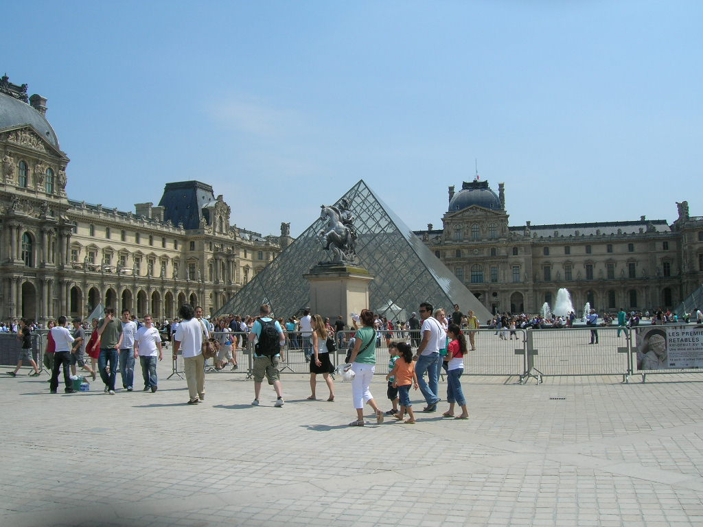
Le musée du Louvre
Notes:
- The Louvre, founded as a fortress in 1190, has undergone many changes over the years.
- The most recent was the addition of architect I.M. Pei’s glass pyramid, inaugurated in 1989.
- Some critics find the ultramodern pyramid to be too much of a contrast to the centuries-old Louvre.

Slide 21
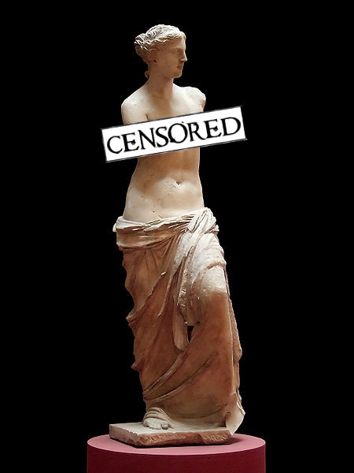
Venus de Milo
Notes:
- Thousands of priceless works of art, such as the Venus de Milo are exhibited in the musée du Louvre.

Slide 22
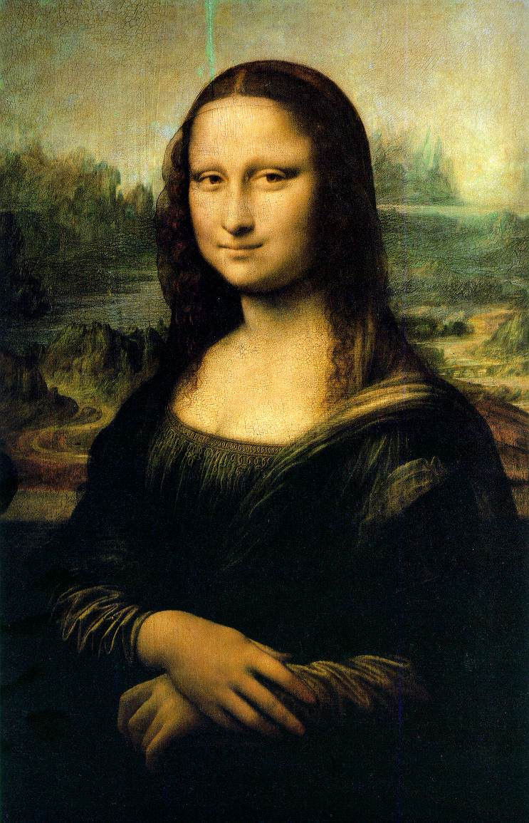
Leonardo da Vinci “La Jaconde” (Mona Lisa)
The Mona Lisa is housed in le musée du Louvre (the Louvre museum) in Paris.

Slide 23
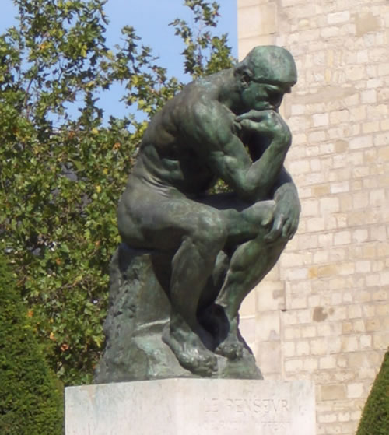
Auguste Rodin “Le Penseur” (The Thinker)
The Thinker can be found in le musée Rodin (the Rodin museum) in Paris.

Slide 24
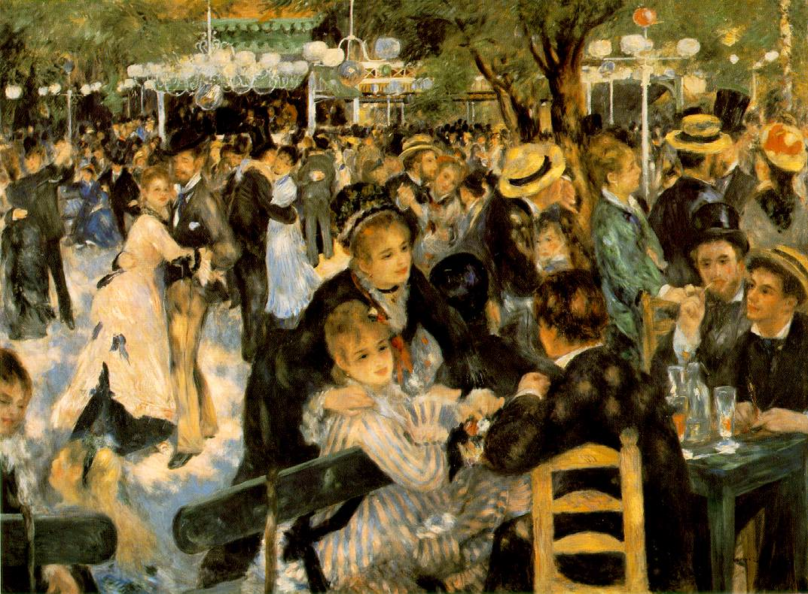
Pierre-Auguste Renoir “Bal du Moulin de la Galette”
This painting can be found at le musée d’Orsay (Orsay museum) in Paris.

Slide 25
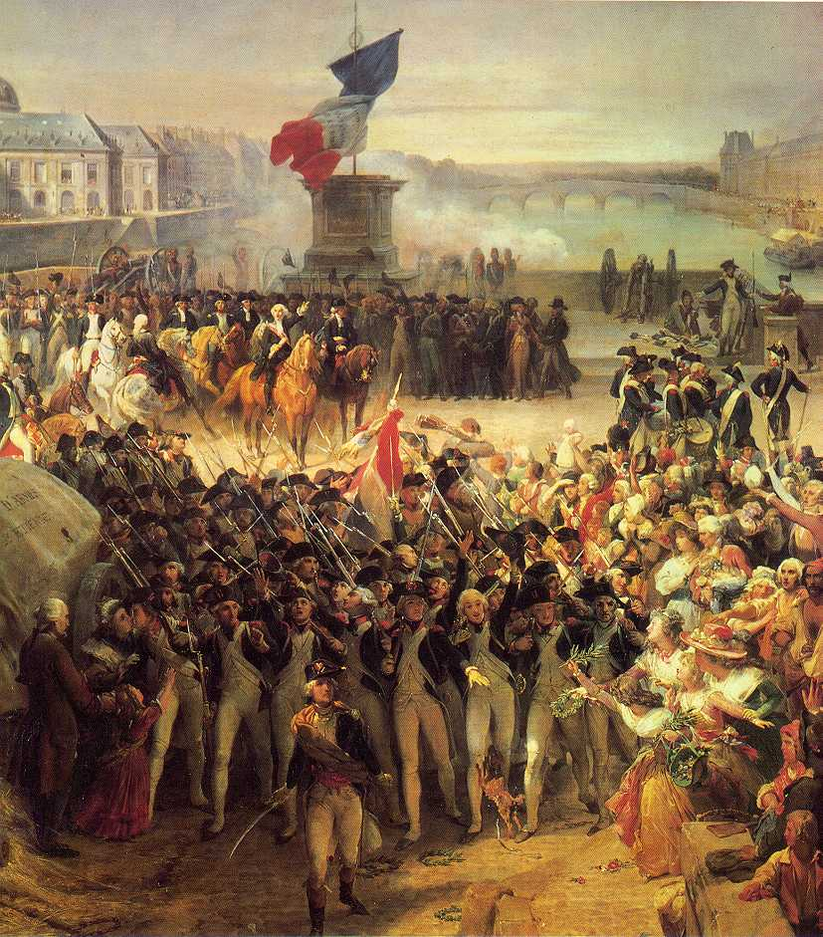
La Révolution française
The 14th of July is France’s national holiday.
It marks the fall of the Bastille prison and is the symbol of the end of the Monarchy.
Notes:
- The liberation of the Bastille prison was an event that sparked the French Revolution in 1789 and ultimately led to the end of the French monarchy.

Slide 26
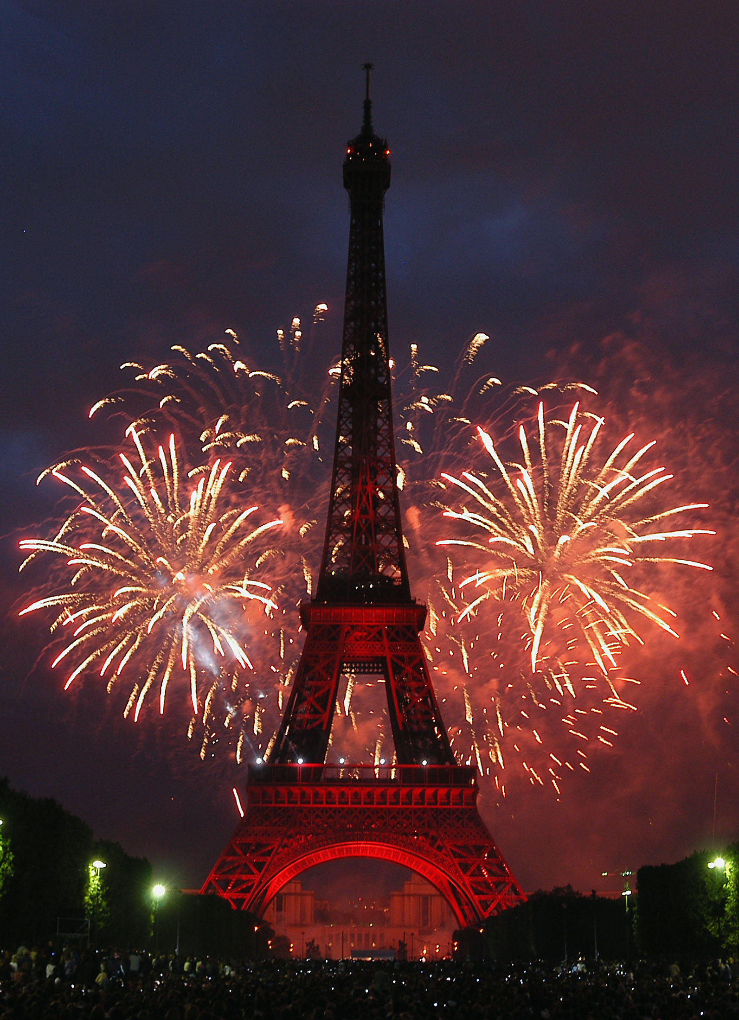
La fête nationale – (Bastille Day)
Notes:
- In Paris and all across France, the holiday is celebrated with fireworks, military parades, and other festivities.

Slide 27
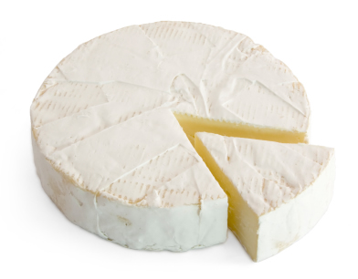
Le fromage – le brie
This cheese, known as the “king of cheese,” is a specialty of Meaux.
Notes:
France produces hundreds of varieties of cheese that range from very mild cheese to very strong ones.
The French are among the finest cheese makers in the world.
L’Île-de-France is home to the famed brie, a soft mold-covered cheese.
Some French cheeses have achieved appelation d’origine contrôlée (AOC) status, meaning that they originate from a specific region and have been made according to strict regulations.
Brie is one AOC cheese made in L’Île-de-France.

Slide 28
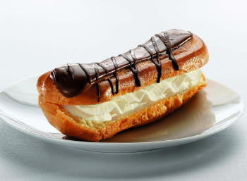
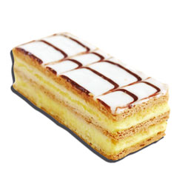
Les pâtisseries
éclairs
tartes aux fruits
millefeuilles
Éclairs, tarte aux fruits, and millefeuilles are typical French desserts.

Slide 29
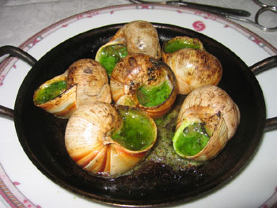
Les escargots
Originally from Burgundy, snails are popular in restaurants all over the country.

Slide 30
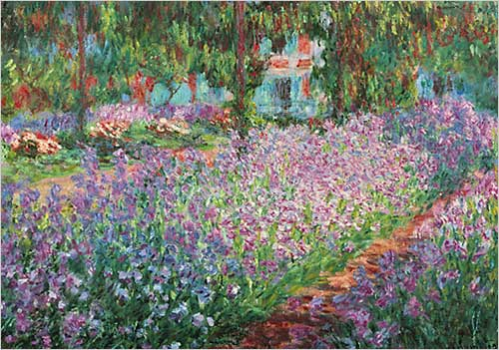
Claude Monet
One of the most significant painters of the Impressionist movement.
Notes:
- Many of his paintings were inspired by the gardens in Giverny situated in the outskirts of the Île-de-France.

Slide 31
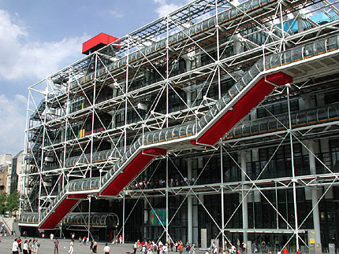
Le Centre Pompidou
Le Centre Pompidou, or Beaubourg, houses the leading collection of modern and contemporary art in Europe.

Slide 32
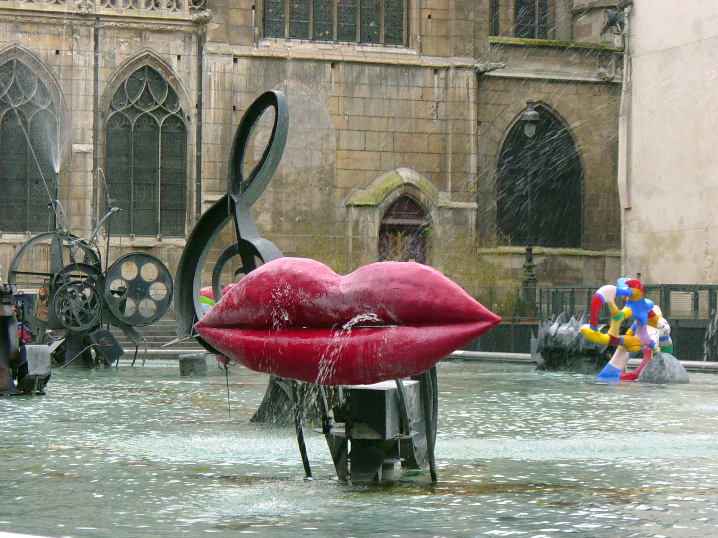
La fontaine Stravinsky
This fountain, near the Beaubourg, consists of sixteen separate sculptures set in motion by the force of water.
Notes:
- Niki de Saint Phalle (1930-2002) created the colorful figures of the fountain.

Slide 33
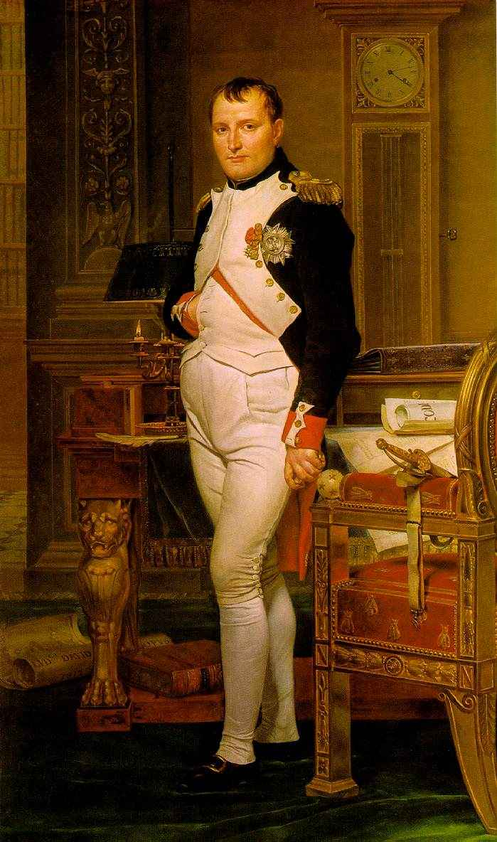
Napoléon Bonaparte (1769-1821)
Emperor of France
Died in exile on an island called St. Helena
His remains were returned to France and were buried in the Invalides, in Paris.

Slide 34
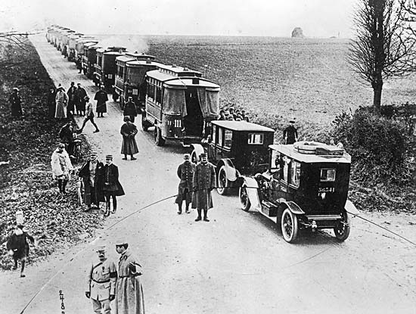
La Bataille de la Marne
In September 1914, French soldiers were transported to the battlefield outside Paris using a fleet of about 600 taxi cabs.
This incident is referred to as taxis de la Marne.
Notes:
- During WWI, German forces were close to overcoming French forces near the Marne River outside of Paris.
- French military authorities dispatched emergency troop reinforcements from Paris.
- On September 7, 1914, a fleet of Parisian taxicabs ferried about 6,000 reserve infantry troops to the front.
- The strategy worked, and Paris was saved.

Slide 35
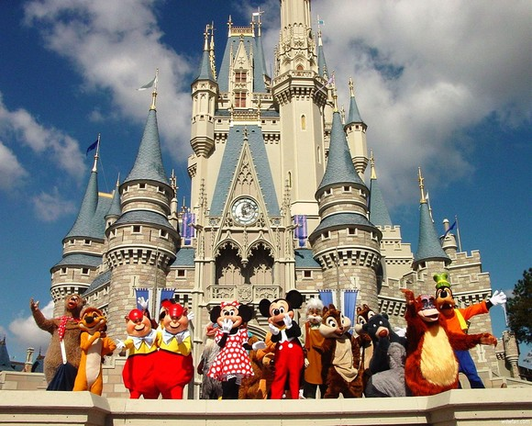
Disneyland® Paris
opened its doors in Marne-la-Vallée in 1992.

Slide 36
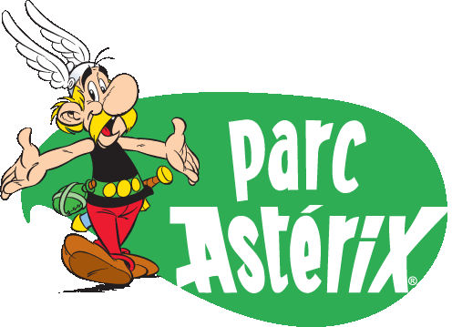
Le Parc Astérix®
In this theme park, you can meet the French comic strip character Astérix and his friends.
Notes:
- Astérix the Gaul (comic book character) might be one of the best-loved characters to come out of French popular culture.
- Astérix and his friends provide a humorous look at the period around 50 B.C. when the Romans were expanding their empire and were meeting with fierce resistance from the native inhabitants.

