Slide 1
Direct Object Pronouns in French
me, you, him/it, her/it, we/us,
you (polite or plural), them

Slide 2
What is a direct object pronoun?!?!
?!

Slide 3
Before we ask ourselves that…
?!

Slide 4
What is a pronoun?
A PRONOUN IS:
“a word that replaces a noun in a sentence”.

Slide 5
“John talks a lot every day!”
In this sentence, John is a noun.
A noun is a naming word.

Slide 6
“He talks a lot every day!”
In this sentence, he replaces the noun.
He is a pronoun.

Slide 7
For example
Michael is nice.
Claire is happy .
Bonnie and Jean are talking.
Me and Mike are eating.
He is nice.
She is happy.
They are talking
We are eating.

Slide 8
So what is a direct object pronoun?

Slide 9
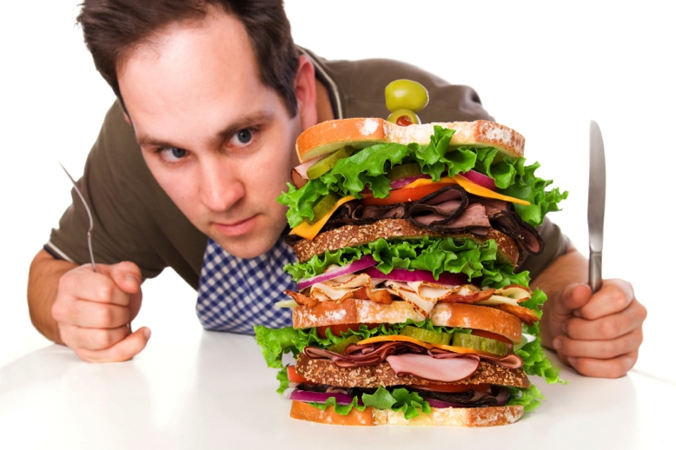
Let’s look at a verb…
Let’s choose the verb to eat.

Slide 10
Let’s look at a sentence…
Michael eats the burger
Subject verb direct object

Slide 11
Let’s look at a sentence…
He eats the burger
Pronoun verb direct object

Slide 12
Let’s look at a sentence…
He eats it
Pronoun verb direct object pronoun

Slide 13
For example:
I hit Michael.
I hit Claire.
The thunder hit Bonnie and Jean.
The dog licked the bowl.
I hit him.
I hit her.
The thunder hit them.
The dog licked it.

Slide 14
Direct Object Pronouns in English
Noun
Michael
Claire
Bonnie and Jean/ the cars
The bowl
Direct Object Pronoun
Him
Her
Them
It

Slide 15
For example:
I hit Michael.
I hit Claire.
The thunder hit Bonnie and Jean.
The dog licked the bowl.
I hit him.
I hit her.
The thunder hit them.
The dog licked it.

Slide 16
What about in French???
?!

Slide 17
Let’s look at a verb…
Let’s stick with the verb manger.

Slide 18
Let’s look at a sentence…
Michel mange le burger
Subject verb direct object

Slide 19
Let’s look at a sentence…
Il mange le burger
Pronoun verb direct object

Slide 20
Let’s look at a sentence…
Il le mange
Pronoun verb direct object pronoun

Slide 21
What do you notice?

Slide 22
What do you notice????
Il mange le burger
Il le mange

Slide 23
The word order changes!
In French, the direct object pronoun goes before the verb!
Tu mange le fromage
Tu manges les burgers
Elle mange la vache
Tu le mange
Tu les manges
Elle la mange

Slide 24
Direct Object Pronouns in French
Noun
Him
Her
Them
It
Direct Object Pronoun
le
la
les
le/la

Slide 25
WAIT!
Don’t le, la and les mean ‘the’?!

Slide 26
How do they work in French?
J’ai une télévision. Je l’aime. Je la regarde tous les jours.
But I thought l’ & la meant « the »??!
How do we know that l’ and la don’t mean “the” in the sentence at the top?

Slide 27
How do they work in French?
Think about the part of speech that le, la, l’ or les would normally come in front of in French ...
J’ai une télévision. Je l’aime. Je la regarde tous les jours.

Slide 28
How do they work in French?
YES! They come in front of
NOUNS
e.g.
le stylo
la porte
l’eau
les enfants

Slide 29
How do they work in French?
Now look at the sentence again and work out what part of speech l’ and la are coming in front of:
J’ai une télévision. Je l’aime. Je la regarde tous les jours.

Slide 30
How do they work in French?
YES! They are now coming in front of
VERBS!
J’ai une télévision. Je l’aime. Je la regarde tous les jours.
Is there anything different about the word order from English?

Slide 31
How do they work in French?
Because “la télévision” is feminine of course!
J’ai une télévision. Je l’aime. Je la regarde tous les jours.
Why is it “l’” in front of “aime”??

Slide 32
Vowel clashes!
OF COURSE!
There is a vowel clash – both “le” and “la” will change into “l’” when the verb begins with a vowel or h-vowel.

Slide 33
Let’s Practise:
J’aime le poisson
Il finit ses devoirs
Il attend le bus
Elle quitte l’école
Jean préfère les frites
Je l’aime
Il les finit
Il l’attend
Elle la quitte
Jean les préfère

Slide 34
Practise time
It’s time to check we all understand.
Look at the handouts you have been given and complete the exercises by replacing the noun with a direct object pronoun in each sentence.
Once we’re all finished, we’ll mark it together.

